Slide 1

Uncertainty-Aware Multi-Horizon Handover Prediction
from Drive-Test Signalling
How far ahead can the next LTE handover be seen, and with what guarantee?
Abeer Saadman
Student ID [ID]
Supervisor: [Supervisor Name, Title]
Department of Electrical and Electronic Engineering
Islamic University of Technology, Gazipur, Bangladesh
B.Sc. Thesis Defence | [Date]

Slide 2


MOTIVATION
LTE hands over with a rule that acts only after the radio has already changed
Event A3 is reactive. It fires once a neighbour is already better by an offset, and stays better through a time-to-trigger.
Everything downstream follows: the interruption, the throughput dip, the ping-pong back.
One or two seconds of warning is enough to prepare, pre-empt or suppress.
Entering condition and TTT per 3GPP TS 36.331. Curves illustrative; parameters are the deployed ones (+1 dB offset, 1 dB hysteresis, 320 ms TTT).

Slide 3
RESEARCH QUESTION
The question this thesis answers, stated once
Given what a phone can observe right now, how well can the next handover be
predicted, how far ahead, and with what guarantee?
How well? Against a prevalence-aware floor, never accuracy on an imbalanced task.
How far ahead? 0.5, 1, 2, 3 and 5 seconds, with the horizons kept mutually coherent.
With what guarantee? A distribution-free bound on missed handovers, per drive.
On what evidence? Real drive-test data with handover truth from decoded RRC signalling.

Slide 4
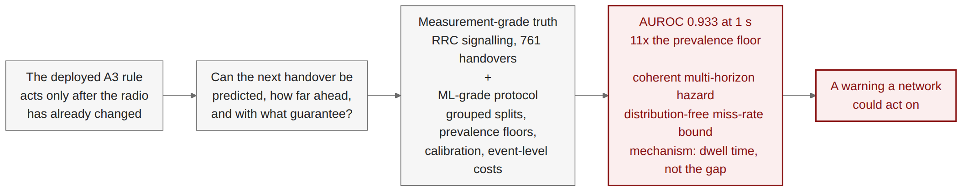
ROADMAP
How the argument runs, end to end
Two halves have to hold together: measurement-grade ground truth, and a protocol a machine-learning reviewer would accept.
Everything after this slide is one of those two halves, or a result that needed both.

Slide 5
LITERATURE
Two literatures exist, and neither does what a deployable predictor needs
Measurement studies
Deng et al., IMC 2018: recover operator mobility configurations from signalling.
Ghoshal et al., 2025: handover configurations across three US operators, 48k handovers.
Strength: measurement-grade ground truth.
Gap: they build no predictor.
Prediction studies
108 references screened over three passes; 22 predict handover, radio-link failure or next-cell occupancy.
Mostly simulation, mostly without grouped splits.
Strength: models and architectures.
Gap: protocol, calibration, operating cost.
Deng et al. (2018) IMC; Ghoshal et al. (2025) arXiv:2511.03116. Screening protocol and full audit in the thesis.

Slide 6

LITERATURE
Of 22 comparable papers, none splits by drive and none reports calibration
The audit is on protocol, not on headline numbers.
The survey was widened twice. These rows did not move.
Naming the exceptions: five split on a unit coarser than a row - by zone, device, time, travel day, deployment event. None is a per-timestep task on measured radio.
This is the gap: measurement-grade truth on one side, an ML-grade protocol on the other.
Screened set of 108 references; 22 are models predicting handover, RLF or next-cell occupancy. Counting rules stated in the thesis.

Slide 7
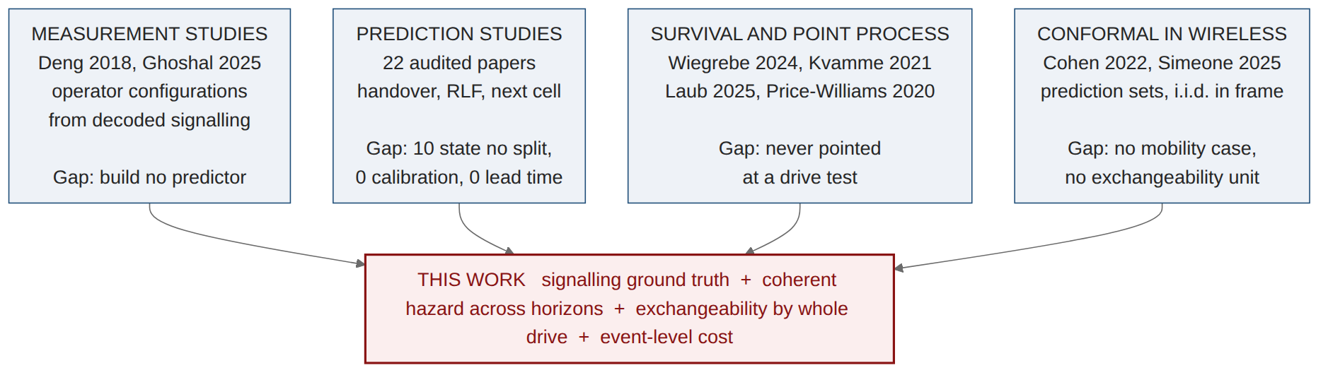
LITERATURE
Four literatures nearly meet here, and none of them quite touches
Measurement studies have the ground truth and build no predictor.
Prediction studies build predictors on simulation, without grouped splits, without calibration.
Survival and point-process methods are mature and have never been aimed at a drive test.
Conformal has entered wireless, but for i.i.d.-in-frame signal processing, not a mobility event stream.
Pass-3 literature map. Full thread-by-thread synthesis in the thesis.

Slide 8
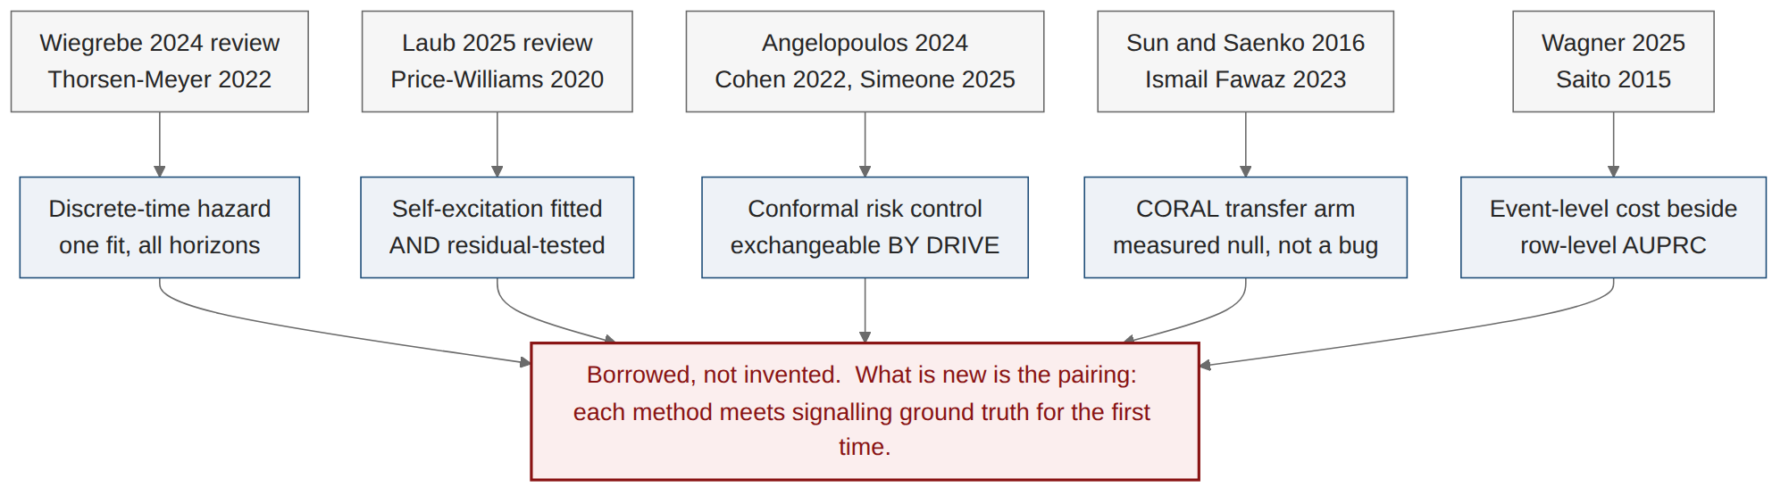
LITERATURE
Every method here is borrowed on purpose; what is new is where it is pointed
Nothing here is invented. Every component has a primary source.
Residual-testing a Hawkes fit is the local norm in network traffic, not a flourish.
The CORAL null is credible: a nine-method benchmark finds published adaptors losing to source-only training.
Borrowing well is a contribution when the pairing is new and the protocol is honest.
Primary sources cited in the section that uses each method, not only in related work.

Slide 9
LITERATURE
Two claims the widened survey forced me to make smaller
Conformal prediction in wireless is not new. Cohen et al. (2022) and Simeone et al. (2025) got there first. What survives as mine is narrower and better defended: their guarantee is over prediction SETS for tasks that are i.i.d. within a frame; mine is a RISK guarantee on an operator KPI over a stream exchangeable only by whole drive. The exchangeability unit is the contribution; the feasibility floor n ≥ 1/α − 1 is its consequence.
The grouped-split claim has now been amended twice. Doc 21 found one paper splitting by time. Pass 3 found two more - by travel day, and by deployment event. The honest form: ten of 22 state no split at all, five split on a unit coarser than a row, and none holds out the mobility unit for a per-timestep classification task on measured radio.
Why say this out loud in a defence. The leakage result in this talk does not depend on scarcity. It depends on the inflation being real and differential - 92% for a GRU against 12% for logistic regression - and that was measured, not asserted.
Doc 22, sections 2M and 4. Both narrowed claims are stated in the thesis limitations section as well as in the positioning section.

Slide 10

DATA
measId and reportConfigId are message-scoped, so a flat parse misattributes silently
The symptom that gave it away: 99.4% of reports resolved to A3, which is impossible when 43% of reports carry no neighbour.
Found by comparison, not by inspection - checking our extraction against a published method.
It changed four claims, two of them ours. The deployed offsets are negative, not the +3 dB assumed in published work on this network.
RRC measConfig is incremental: AddMod inserts or replaces. The timeline reconstructs the state in force at each report.

Slide 11
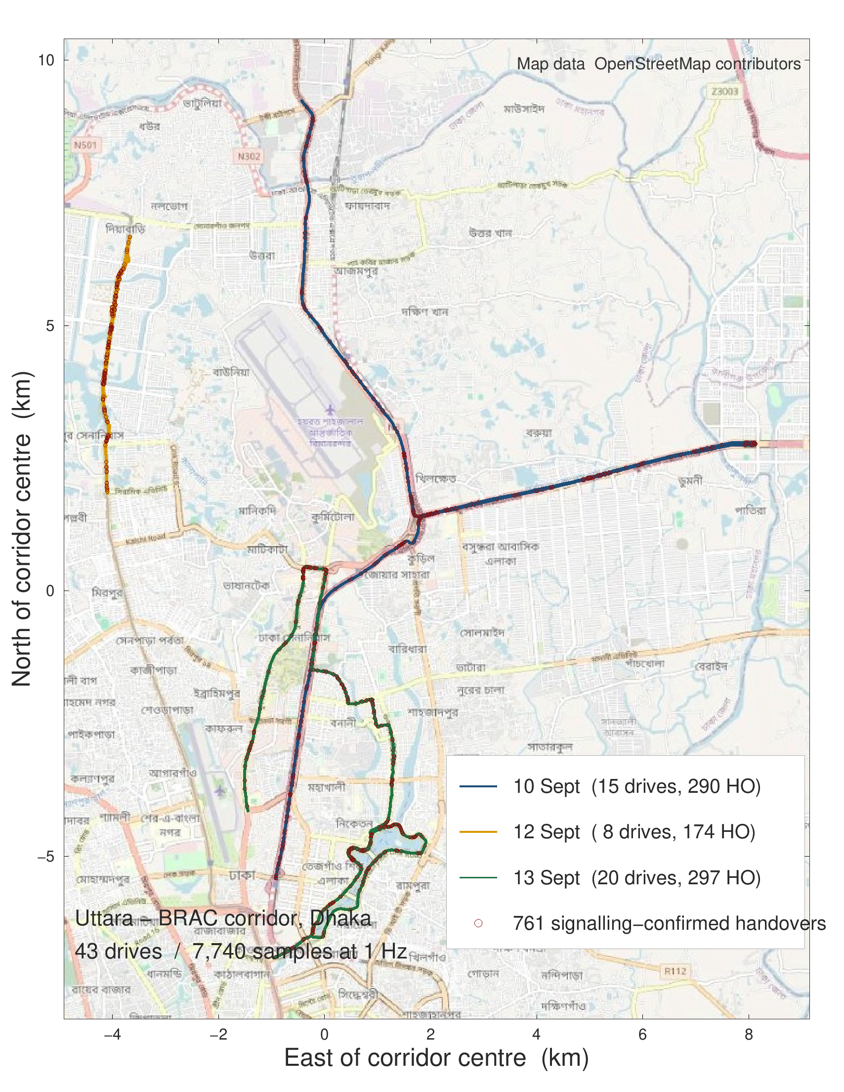
DATA
43 drives over one Dhaka corridor, 761 confirmed handovers
One corridor, three days. Uttara to BRAC University, repeated traversals in evening traffic.
The drive is the unit of everything: segmentation, grouping, bootstrap, and the risk-control guarantee.
Handovers are dense: roughly one every ten seconds of driving.
GPS from the XCAL export; handover positions joined to the 1 Hz grid by nearest timestamp. Figure generated in MATLAB over OpenStreetMap tiles (map data (c) OpenStreetMap contributors, ODbL).

Slide 12
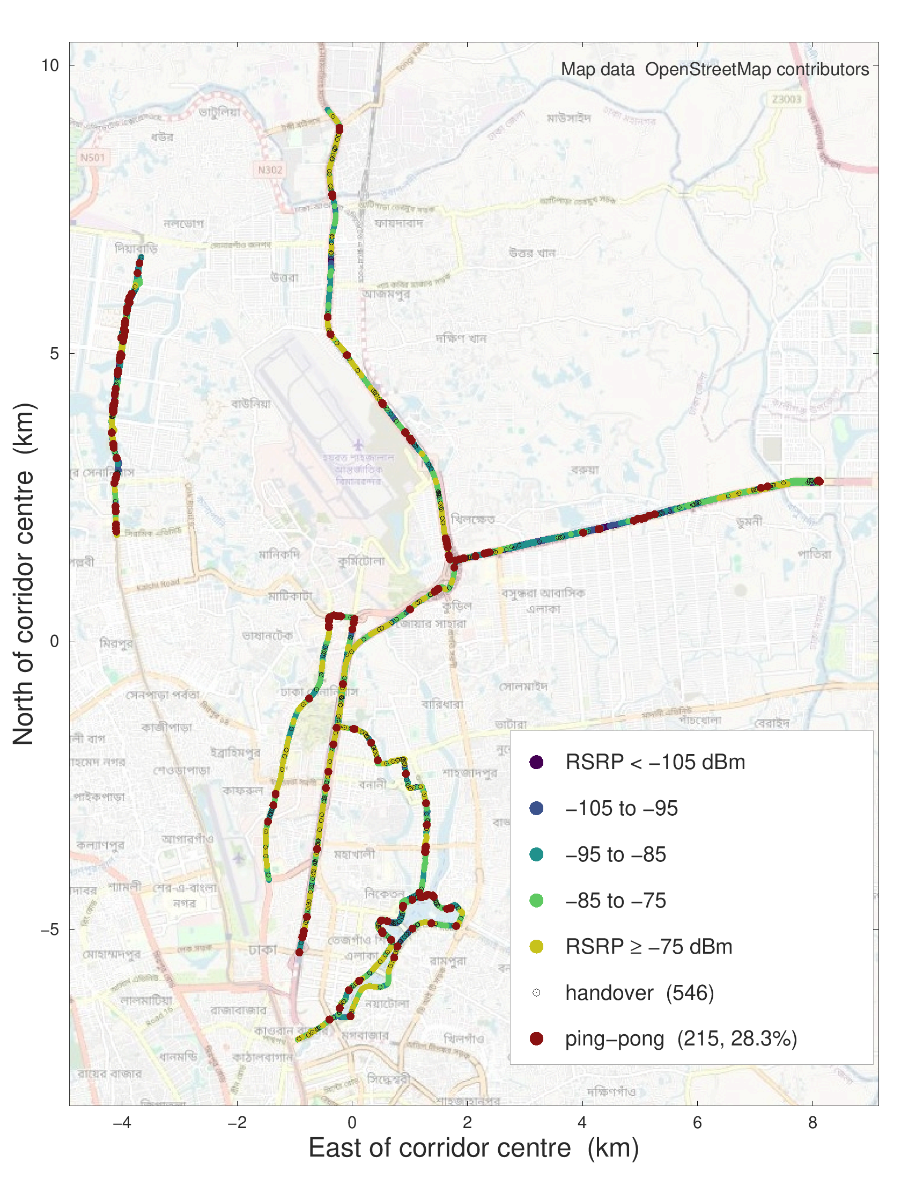
DATA
Handovers cluster where the link is weak; 28% are ping-pongs
Ping-pong is not rare: 215 of 761 handovers return to the cell just left.
It is not uniform either: the clusters sit at specific junctions, not along the whole route.
This is what motivates the self-exciting point-process analysis later in the talk.
Ping-pong defined at the literature-standard 15 s return window with a per-handover denominator. Figure generated in MATLAB over OpenStreetMap tiles (map data (c) OpenStreetMap contributors, ODbL).

Slide 13
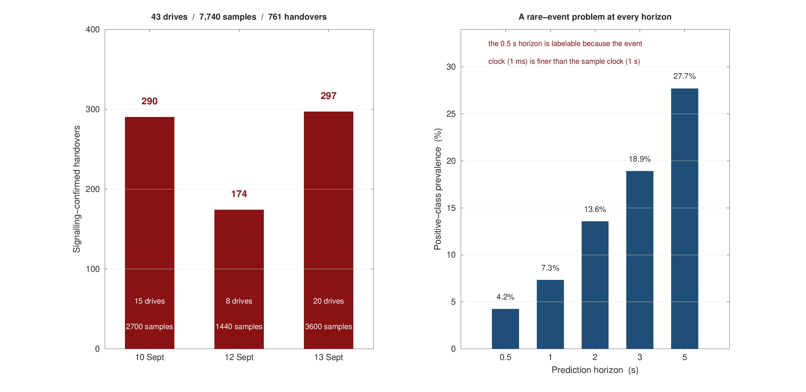
DATA
Every horizon is a rare-event problem, so every metric is read against its floor
7,740 samples on a uniform 1 Hz grid across 43 drives.
Prevalence moves from 4.2% at 0.5 s to 27.7% at 5 s - accuracy would be meaningless.
The 0.5 s horizon is legitimate: the event clock is millisecond-precise even though the sample clock is not.
Label prevalence computed on labelable samples only; drives shorter than 60 s are rejected by quality control.

Slide 14
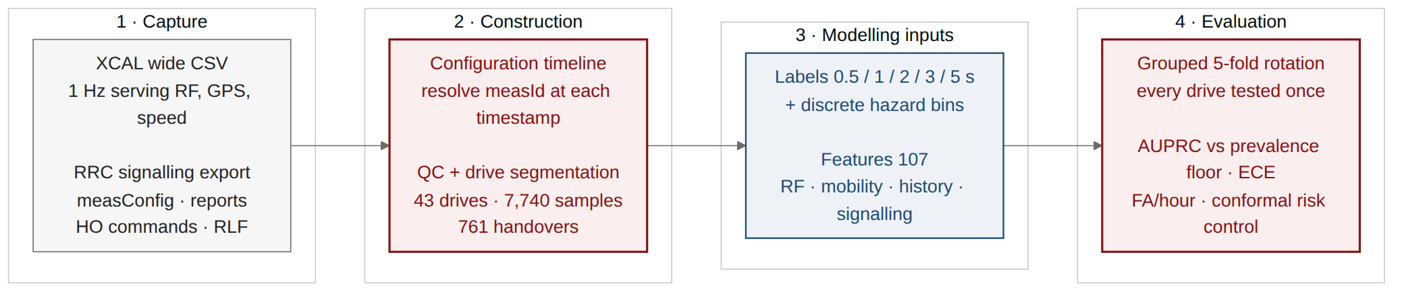
METHOD
One pipeline, with the leakage guards built into its architecture
18 stages, 17 passing tests. Every number in the thesis is written by a stage, not typed.
The guards are structural, not conventions: grouping is by whole drive, and nothing from a test fold is ever fitted.
Reproducible: a rebuild from the raw captures returns 7,740 samples and 761 handovers exactly.

Slide 15
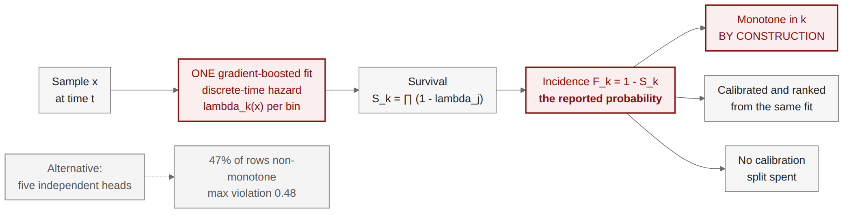
THEORY
Handover prediction is a discrete-time survival problem, not five separate binary tasks
Five independent heads can contradict each other. A 1 s alarm above a 2 s alarm is impossible, yet 47% of rows did exactly that.
One hazard fit fixes it by identity, not by post-processing - and the property holds for any learner.
One consequence worth stating: class reweighting is forbidden here, because it compounds through the product.
Discrete-time survival with right-censoring at the end of each drive.

Slide 16
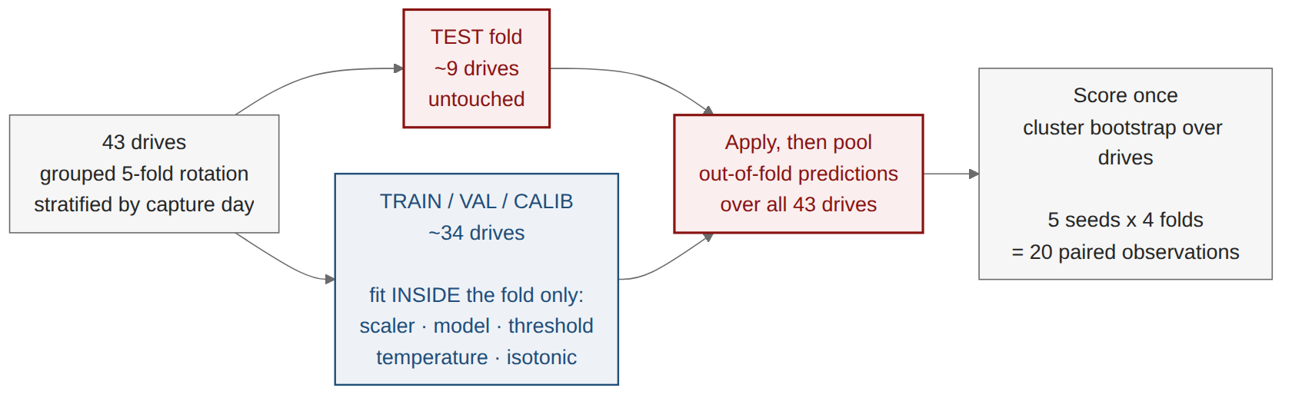
METHOD
Every drive is tested exactly once, and nothing from a test fold is ever fitted
Why not one 15% split? 43 drives leave 6 in test, and a bootstrap over 6 groups is wide for the wrong reason.
Paired testing needs power: with 4 folds a two-sided Wilcoxon cannot return below p = 0.125 whatever the data says.
So the whole rotation repeats over 5 seeds, giving 20 paired observations and a bootstrap interval on every delta.

Slide 17
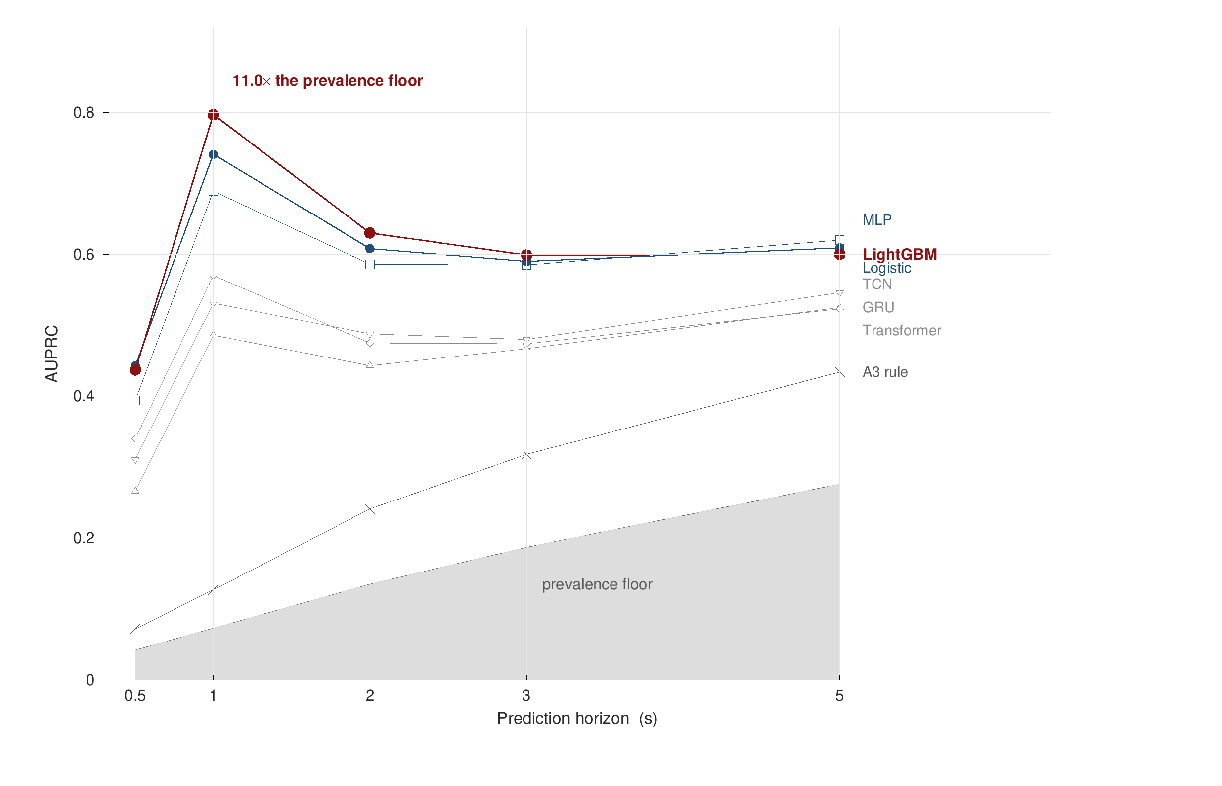
RESULTS
Gradient boosting reaches AUROC 0.933 at 1 s - eleven times the prevalence floor
AUPRC 0.797 at 1 s, ECE 0.025, recall 0.754 at a 5% false-positive rate.
A linear model is second. On 43 drives the sequence models have nothing extra to learn.
The deployed rule reaches AUROC 0.656 and detects 5.5% of handovers one second ahead.
Event level: 44.9% of handovers detected at 1 s, 68.1% at 5 s.
Out-of-fold over 43 drives under the grouped rotation. Figure generated in MATLAB from the pipeline tables.

Slide 18
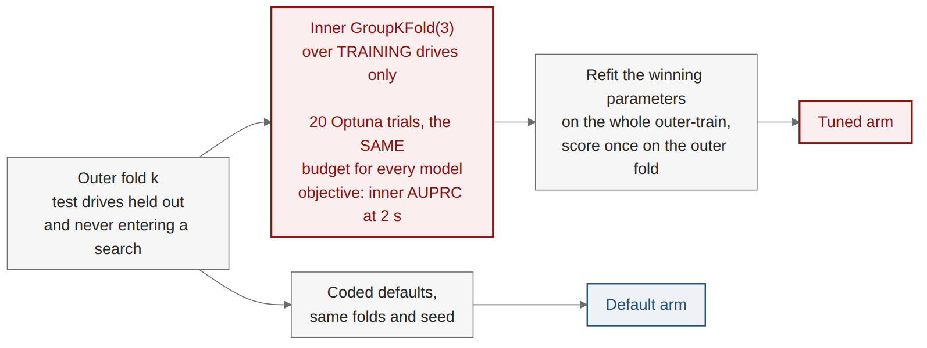
RESULTS
Before claiming a winner, every model was given the same tuning budget
The objection is standard and it deserved a measurement rather than an argument: the deep baselines are under-tuned.
Equal means equal: the same number of trials, the same objective, the same folds, the same seed.
The default arm is re-run here too, so the two arms differ by the parameters alone.
Objective is mean inner AUPRC at the 2 s horizon - the middle horizon, so nothing is tuned to an extreme.

Slide 19
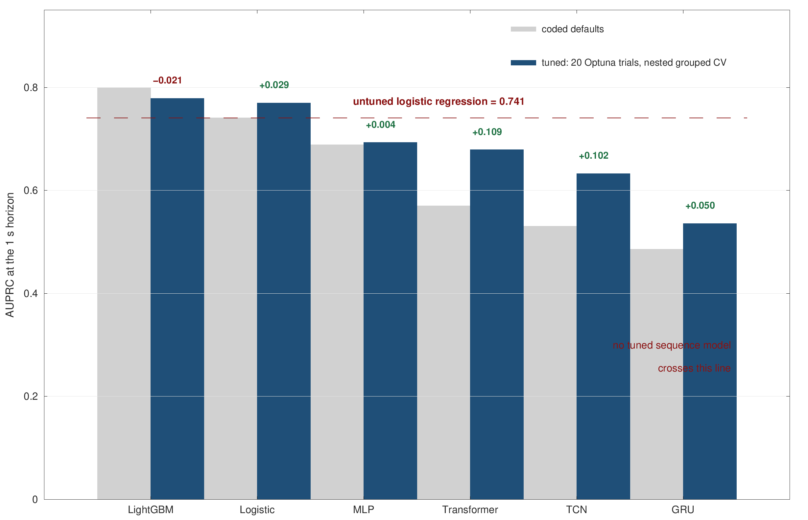
RESULTS
The deep baselines really were under-tuned - and it does not change the answer
They gain a lot: Transformer +0.109 AUPRC, TCN +0.102, both far outside their confidence intervals.
They still lose: no tuned sequence model reaches an untuned logistic regression.
Tuning LightGBM costs 0.021, so its margin is not an artefact of favourable defaults.
One correction falls out: logistic regression's ECE of 0.123 was a class-weight artefact; tuned it is 0.010.
Paired deltas with a drive-level bootstrap interval, 1 s horizon.

Slide 20
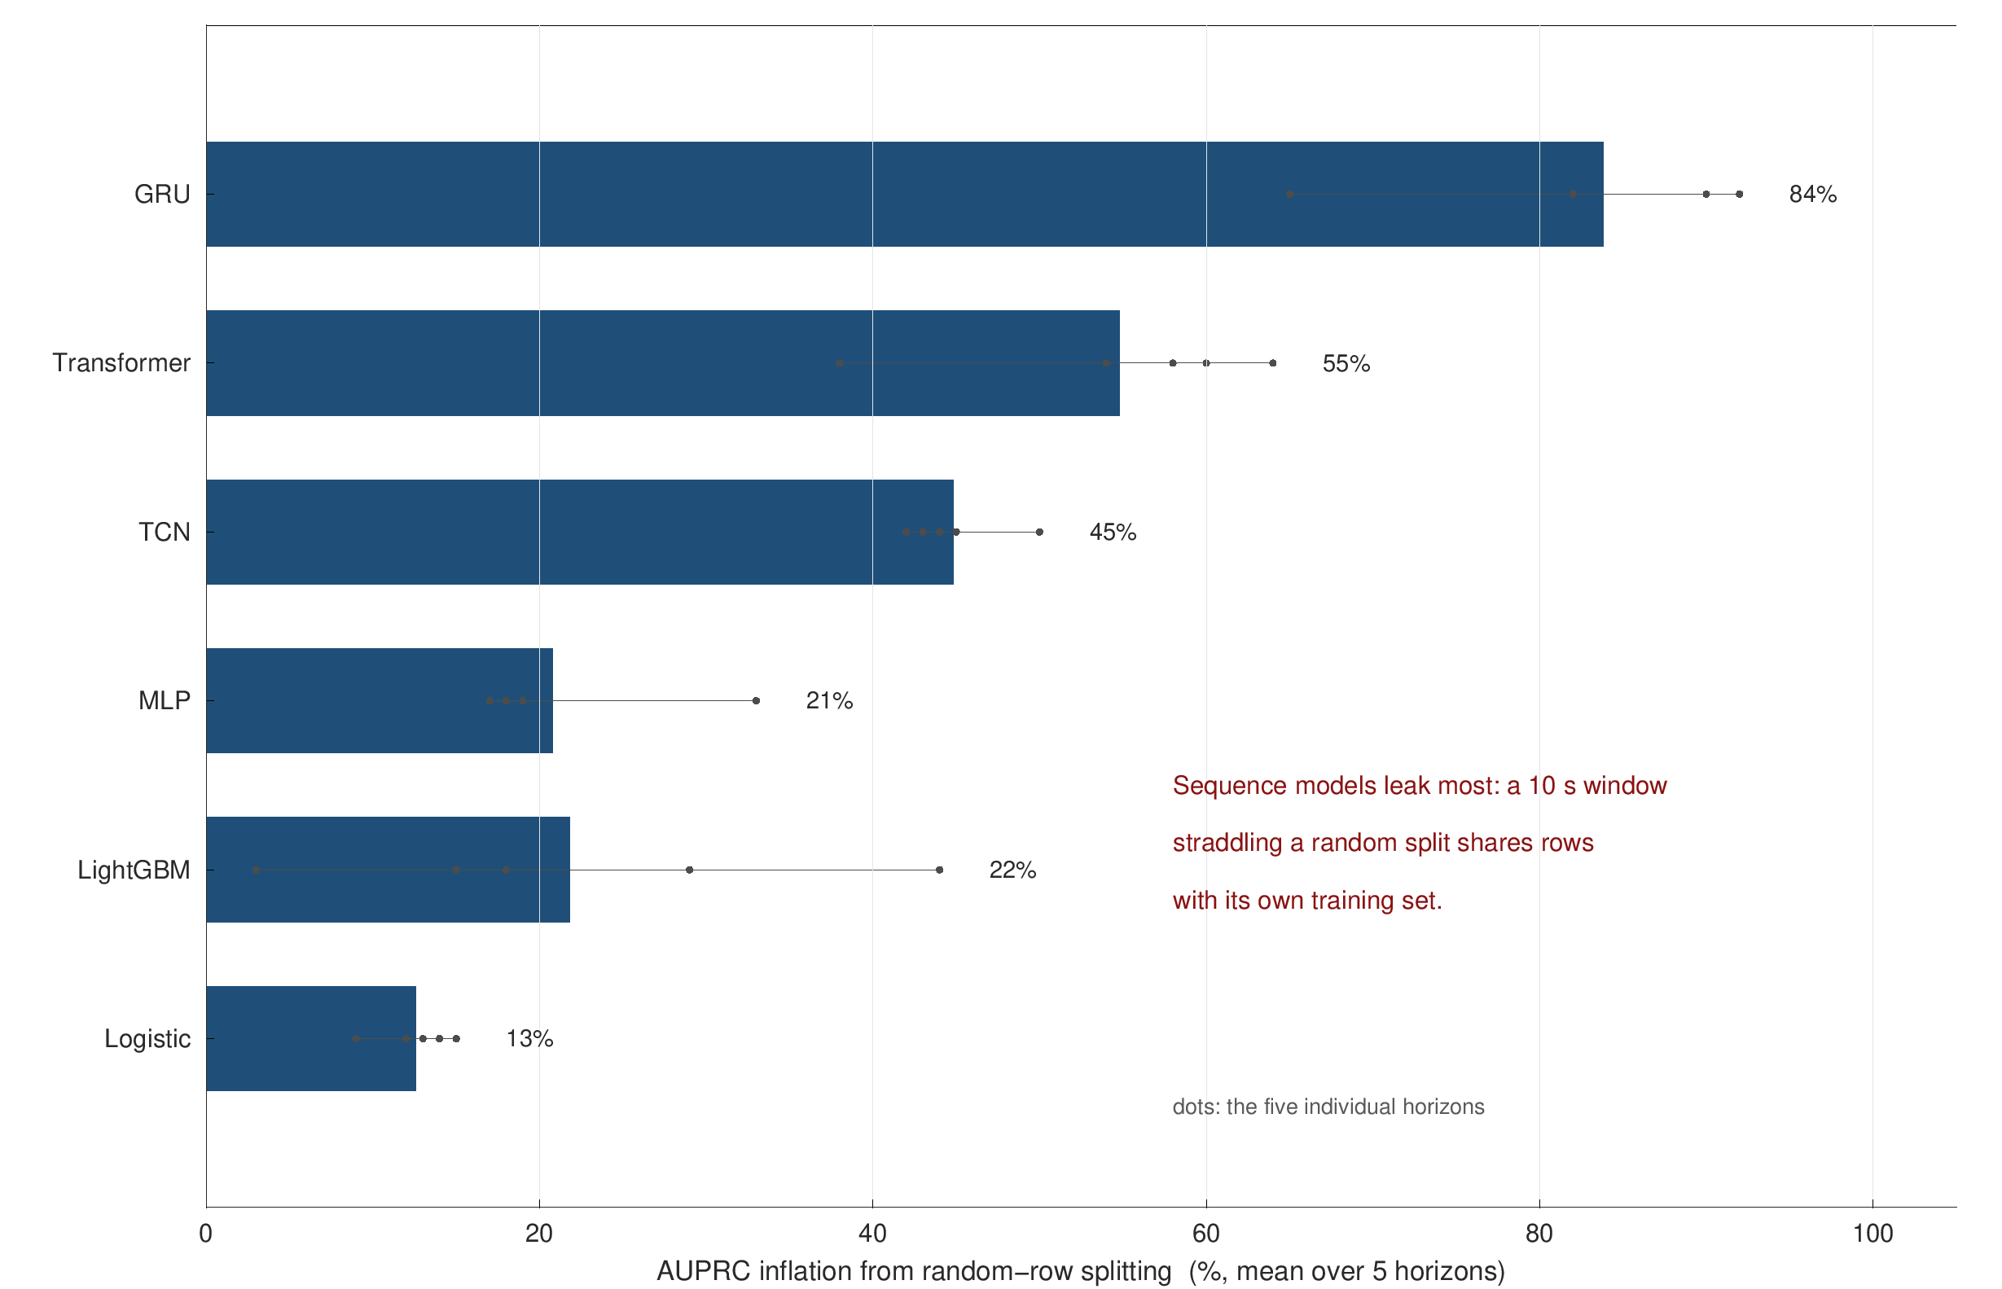
RESULTS
Leakage is architecture-dependent: a GRU inflates by 92%, LightGBM by 18%
Same data, same metrics. The only change is replacing grouped-drive with random-row splitting.
The mechanism: a 10 s window straddling a random split shares samples with its own training set.
Implication for the literature: a published GRU result on a randomly split drive-test set reads as roughly double.
Both arms run under an identical protocol, or the comparison would measure the protocol rather than the leak.

Slide 21
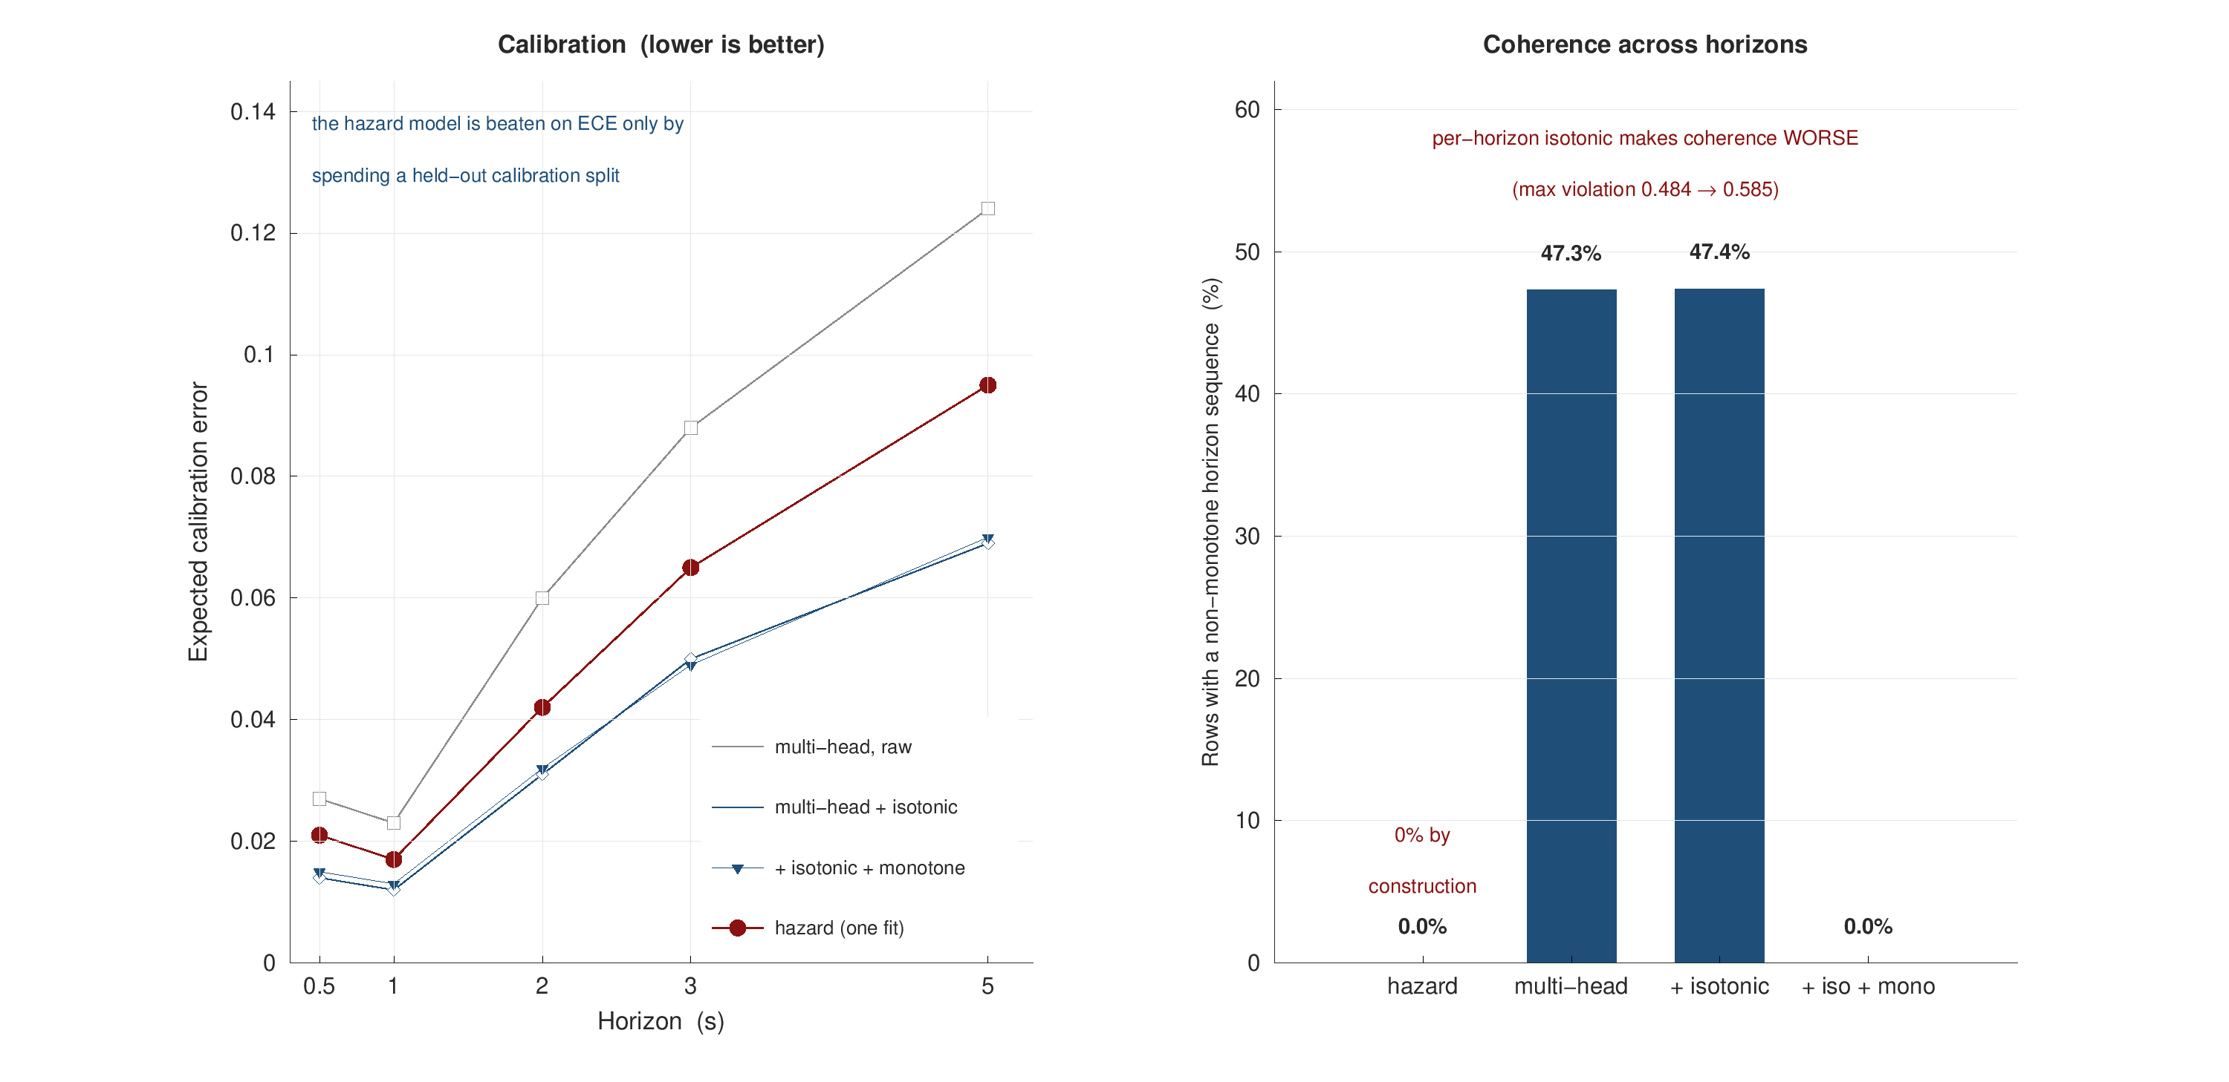
RESULTS
The hazard model earns coherence; per-horizon calibration buys ECE and destroys it
Calibration: better than an uncalibrated baseline, ECE -0.006 to -0.030, p < 0.0001 over 20 paired folds.
But a calibrated baseline wins on ECE - at the cost of a held-out split and 2-5 AUPRC points.
Isotonic alone makes coherence worse: maximum violation grows from 0.484 to 0.585.
The claim, narrowed: calibration, coherence and ranking together, from one fit.
Six arms on identical folds, 5 seeds x 4 folds = 20 paired observations.

Slide 22
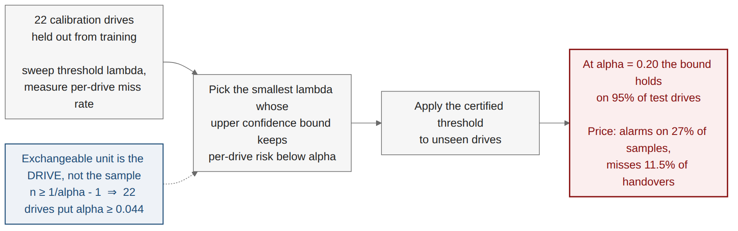
RESULTS
A distribution-free bound on missed handovers, and what it costs to hold it
Not my machinery. Conformal is already in wireless: Cohen 2022, Simeone 2025.
Mine is the exchangeable unit: the whole drive, which sets the floor n ≥ 1/α − 1.
Honest about price: at a 20% target the threshold alarms on 27% of samples.
Below a 15% target it rises steeply, and the frontier is published, not one flattering point.
Prior wireless conformal work bounds prediction SETS for i.i.d.-within-frame tasks; this bounds a KPI over a per-drive exchangeable stream.

Slide 23
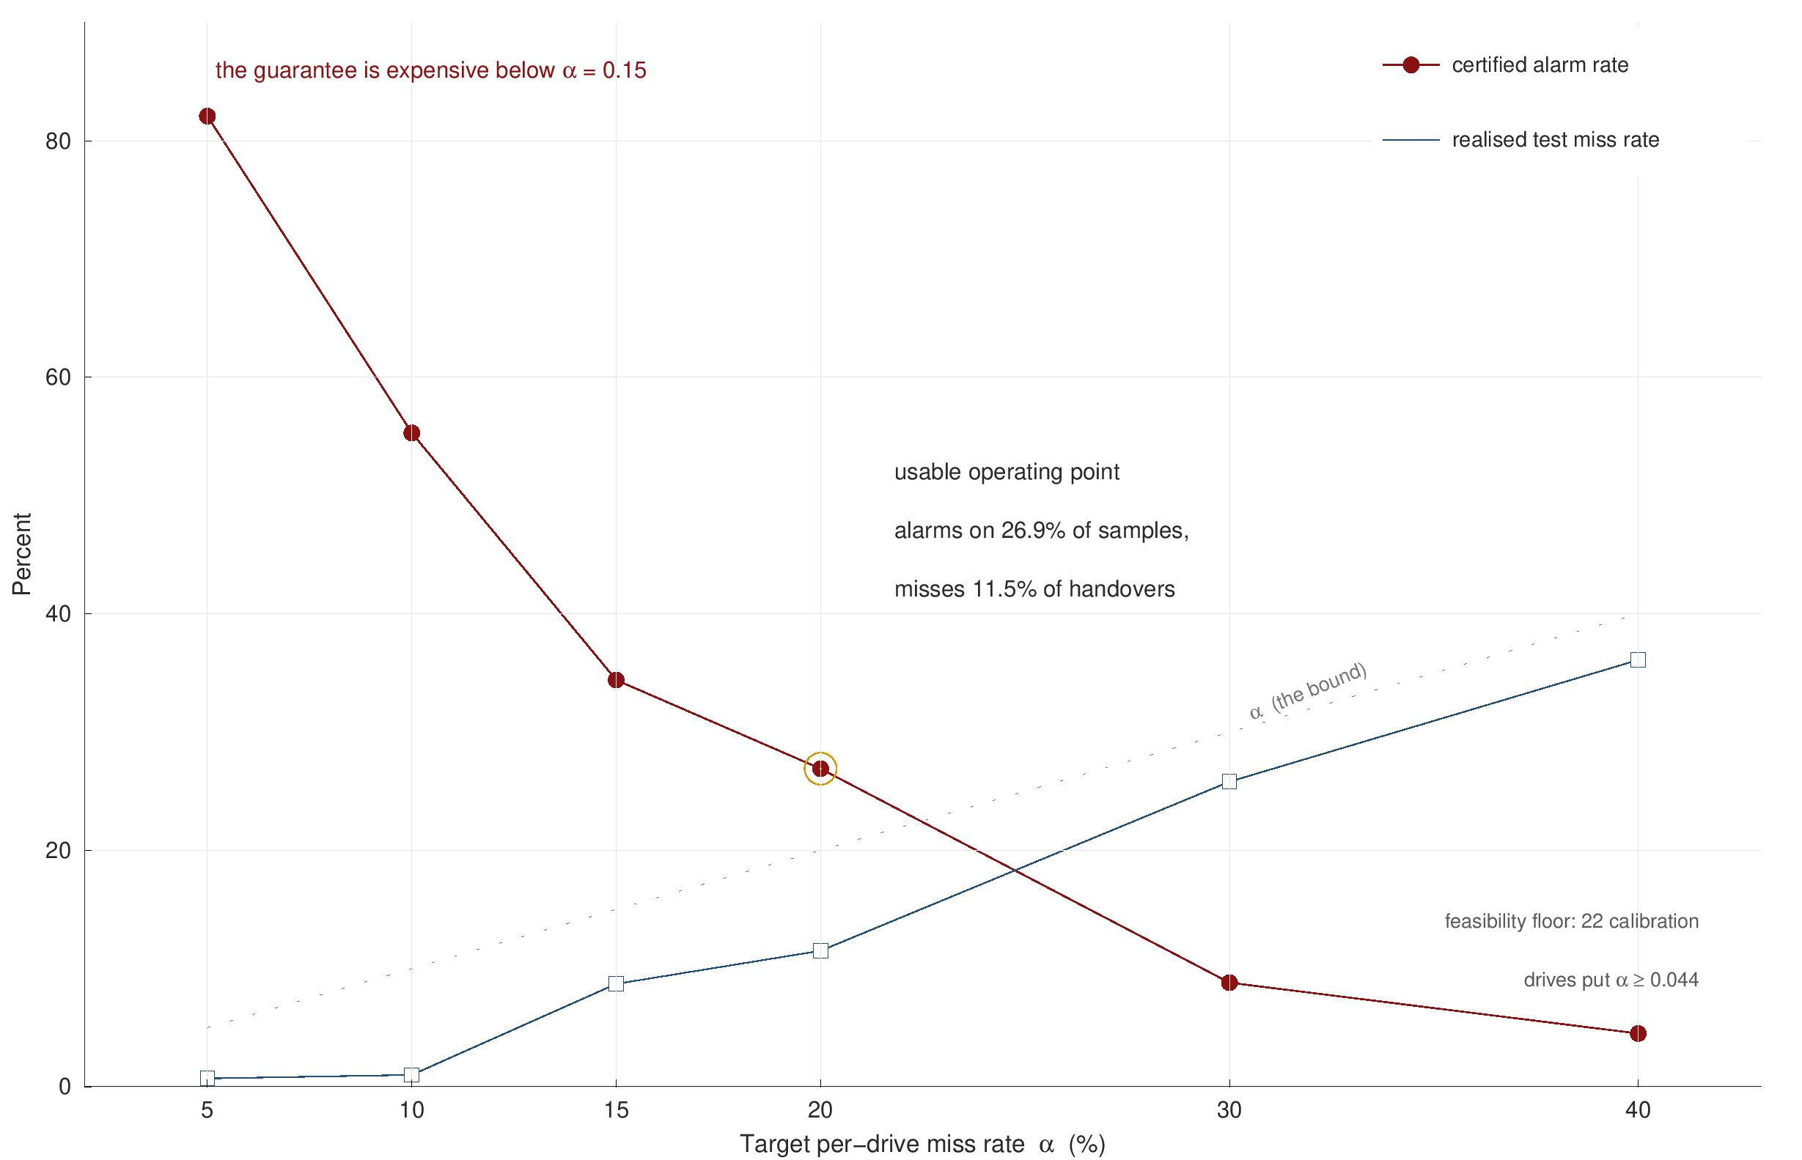
RESULTS
The guarantee is affordable above a 15% miss rate and expensive below it
Two curves, one decision: the certified alarm rate falls as the tolerated miss rate rises.
At alpha = 0.20: alarms on 27% of samples, misses 11.5% of handovers, bound held on 95% of test drives.
At alpha = 0.05 the alarm rate is 82%, which is a guarantee nobody would deploy.
Stated, not implied: a distribution-free bound is not free.
Realised test miss rate stays below the target at every operating point on the frontier.

Slide 24
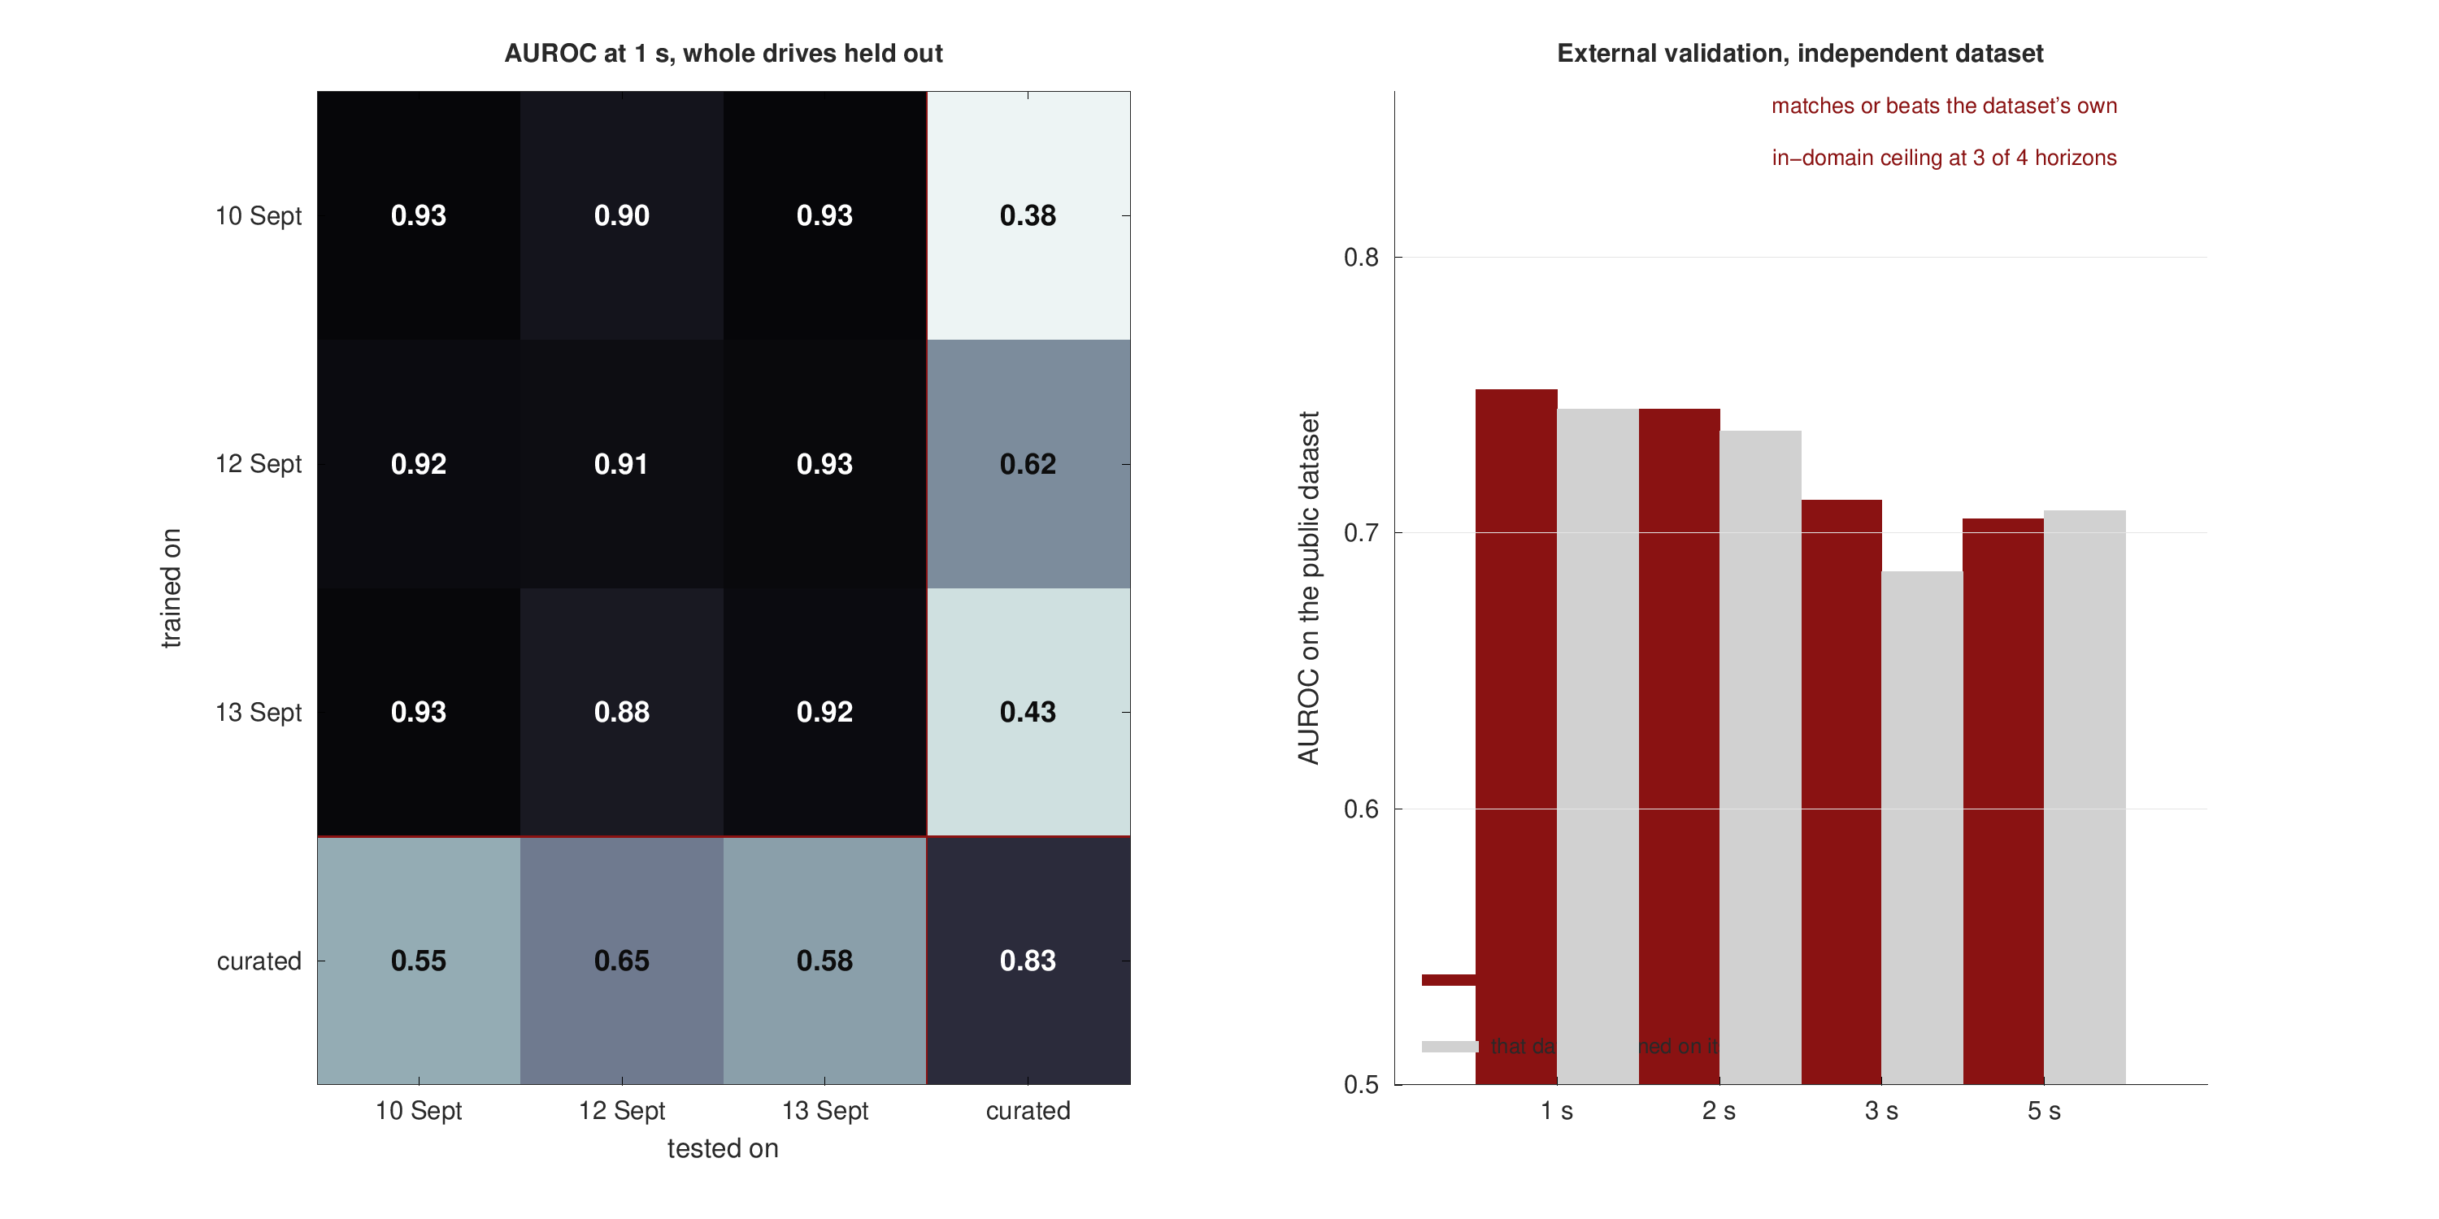
RESULTS
Real-to-real transfer holds, and the model matches an independent dataset's own ceiling
Across captures: AUROC 0.88-0.93 with nothing shared - not drives, routes, cells or scaler.
Out of domain: 0.752 on a public dataset whose own in-domain ceiling is 0.745.
The curated export fails at 0.38-0.62, which is how the synthetic-data audit was independently confirmed.
Across A3 regimes: a real cost of 0.088 AUROC that A3 features do not recover.
Public dataset: Shafi et al. (2025), Mendeley Data, DOI 10.17632/n2pvmtyn2j.1. Our parser agrees 310/310 with the vendor's event counter.

Slide 25
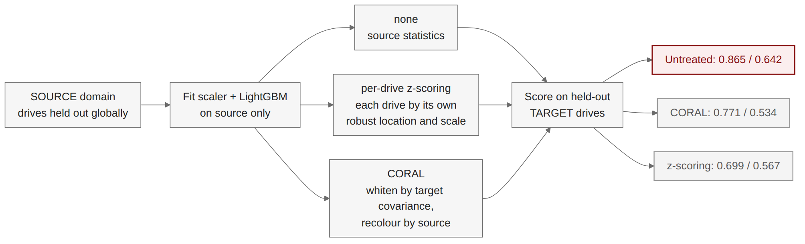
RESULTS
Both zero-cost domain adaptations make transfer worse, not better
Tried in good faith: per-drive standardisation and CORAL - unsupervised, no target labels, free at deployment.
Both lose on both sides, including matched-domain accuracy, which rules out a robustness trade.
Why: the absolute radio level carries the signal, and feature alignment is exactly what deletes it.
LightGBM, identical held-out drives on every arm. Figures comparable across adaptations within this experiment only.

Slide 26
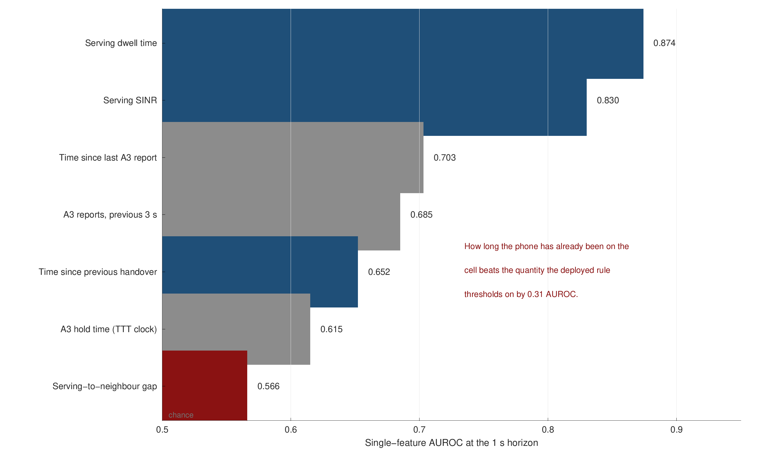
MECHANISM
The quantity the deployed rule thresholds on is the weakest predictor available
Dwell time wins: how long the phone has already been on the cell, AUROC 0.874.
The A3 gap loses: 0.566, barely above chance.
Why: the gap condition is necessary but not sufficient - it holds on 27% of samples, and three in five resulting reports are declined.
Signalling features are informative alone and redundant in combination.
Single-feature AUROC at the 1 s horizon, out-of-fold over 43 drives.

Slide 27
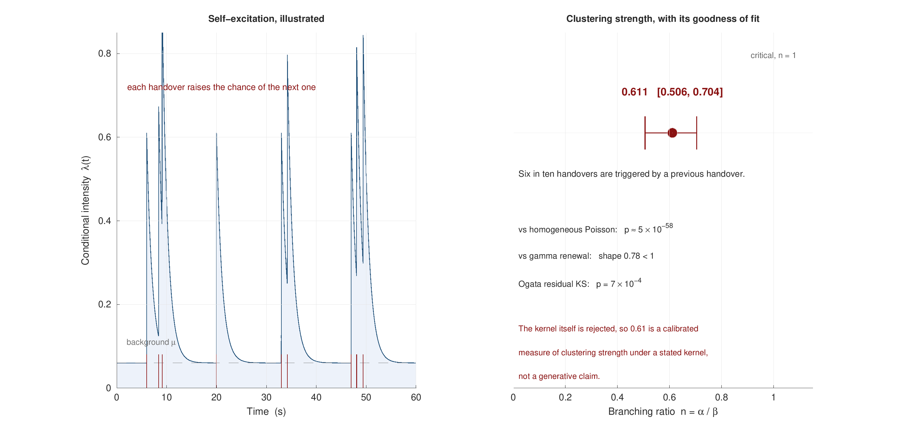
MECHANISM
Handovers are strongly self-exciting: six in ten follow another handover
Branching ratio 0.611 [0.506, 0.704], stable across three captures.
Decisively non-Poisson, and not a renewal process either.
Honest about fit: the exponential kernel is itself rejected by an Ogata residual test.
So 0.61 is a calibrated measure of clustering strength under a stated kernel, not a generative claim.
Pooled over three captures; per-capture Ogata KS p = 0.030 / 0.052 / 0.068.

Slide 28
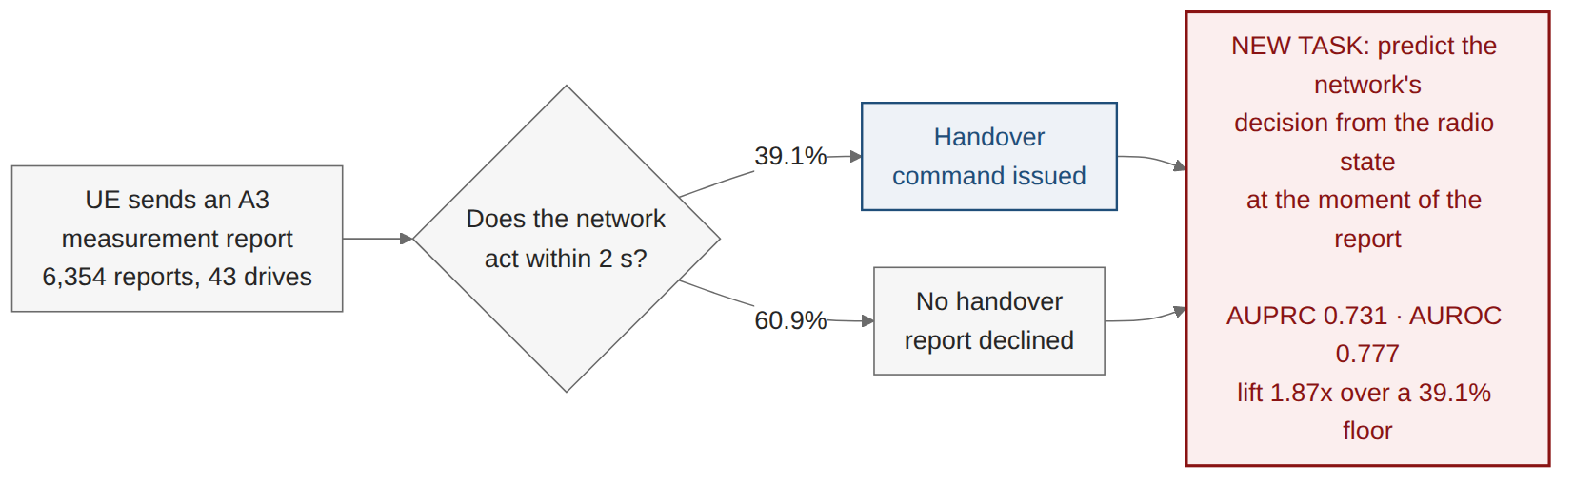
NEW TASK
Three in five A3 reports are declined - and that decision is itself predictable
61.3% non-conversion independently replicates a US-operator finding on a different operator and continent.
Nobody has modelled the network's side of it. Given a report has been sent, will the network act?
It falls straight out of the signalling parser, and it is a clean task a network operator could use directly.
Comparison point: Ghoshal et al. (2025) report 69-87% non-conversion across three US operators.

Slide 29
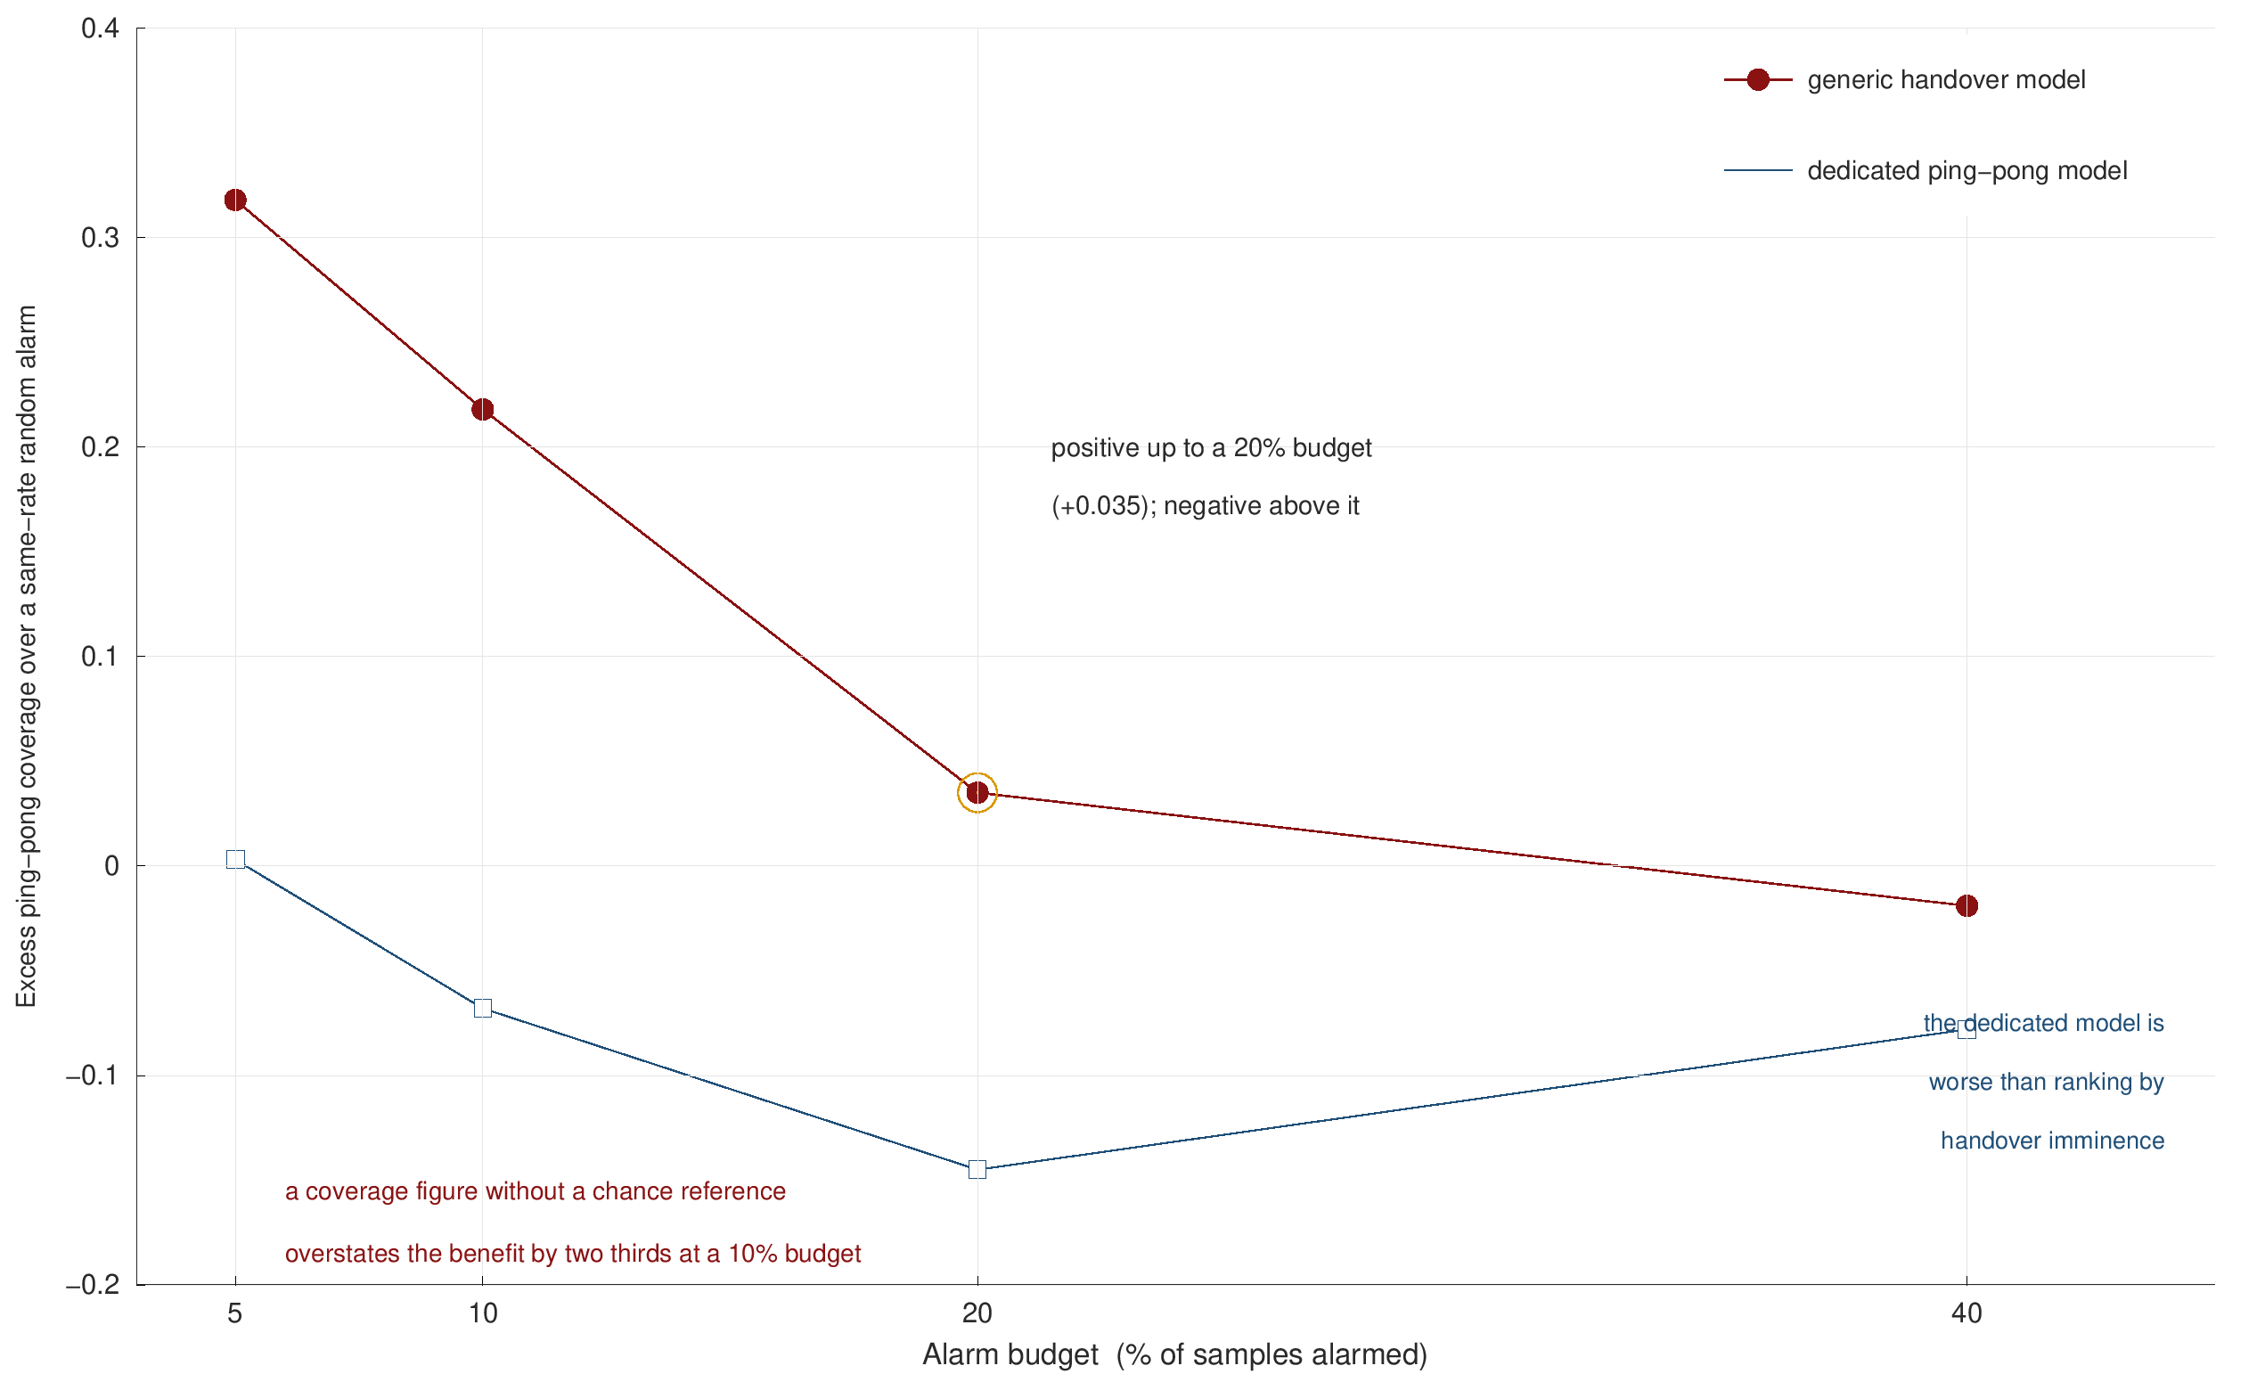
BENEFIT
A warning earns its alarm budget only up to about 20% of samples
Coverage alone is not evidence. The reference is a same-rate random alarm.
Without that reference the benefit is overstated by two thirds at a 10% budget.
A prediction of mine was refuted: a dedicated ping-pong model is worse than ranking by handover imminence.
Because every ping-pong is a handover, and handovers are far more predictable.
Excess coverage over a same-rate random alarm, by alarm budget. Actuator efficacy is stated, not estimated.

Slide 30
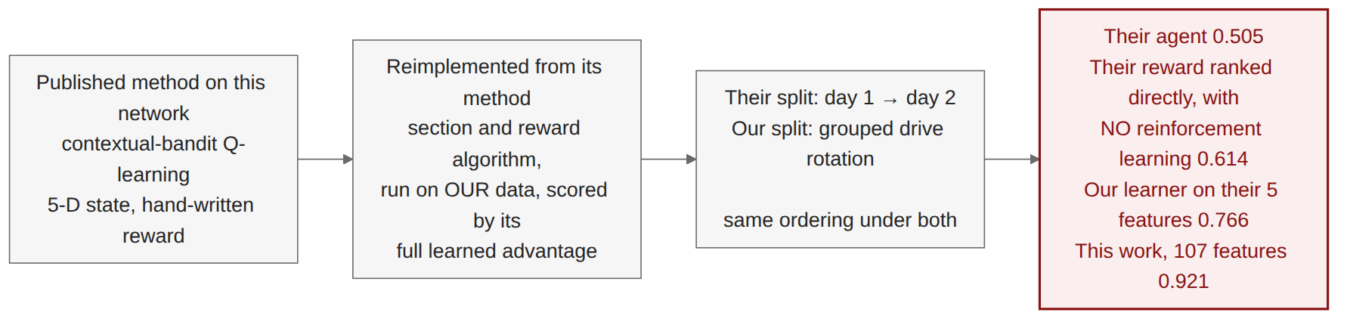
POSITIONING
The nearest published method on this network scores 0.505 where this work scores 0.921
Reimplemented exactly, then scored generously - its full learned advantage, on the rows its own dataset always has.
Their five features are informative: our learner reaches 0.766 from them. The gap is the method, not the inputs.
Their own reward beats their agent, so the reinforcement learning adds nothing the reward did not already contain.
Same operator, city and instrument. No publication record found; held as an unpublished manuscript.

Slide 31
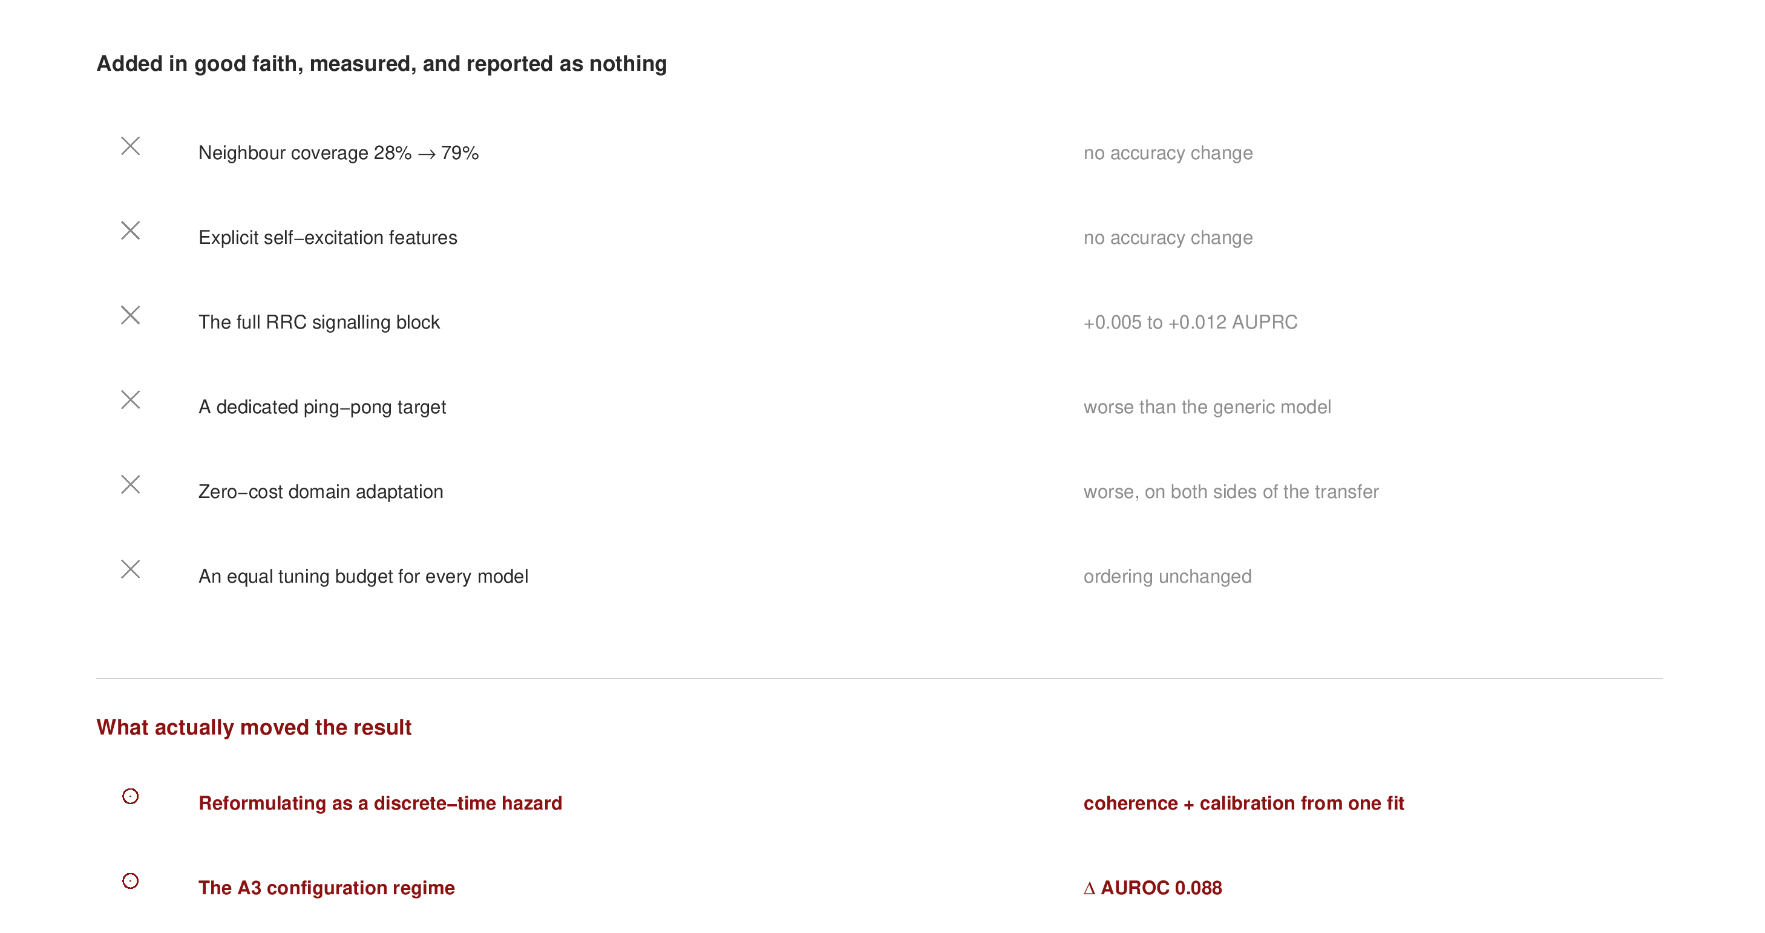
SYNTHESIS
More information and more machinery did not help; formulation and configuration did
Five channels added in good faith, each expected to help, each measured.
Every negative is measured, not assumed - which is what makes the pattern worth stating at all.
Two things moved the result: reformulating the target, and the configuration regime.
Each row is a controlled comparison run under the same protocol.

Slide 32
DISCUSSION
What this work cannot claim
Scale. 43 drives, one corridor, one operator, three days. Enough for grouped cross-validation with 43 bootstrap groups; not enough to claim generality across cities.
Sampling rate. 1 Hz caps event detection at 90.5%. It does not cap horizon resolution - the event clock is finer than the sample clock.
Cross-regime transfer rests on one regime pair. Only two A3 profiles clear the 60-handover bar on an identical test set.
No causal estimate of the actuator. Off-policy evaluation is unidentified here because the logging policy is deterministic: A3 either fires or it does not.
The Hawkes kernel is misspecified, and the thesis says so rather than leaving a reviewer to find it.
Each limitation is stated in the thesis alongside the measurement that bounds it.

Slide 33
DISCUSSION
Four directions, and one of them makes the causal question identifiable
Fuzzy regression discontinuity at the A3 boundary. The identifiable alternative to off-policy evaluation: compare drives just inside and just outside the firing condition.
A second corridor and a third A3 regime. One more capture day on a new route turns one regime pair into a matrix.
Close the loop to an outcome. Connect the two-second warning to a measured throughput or interruption effect, not a counting bound.
Release the code and the dataset. Two of 22 audited papers release code and one releases data; a release is a citable output in its own right.

Slide 34
Conclusions
1. Handover is predictable well ahead of the rule that causes it. AUROC 0.933 and AUPRC 0.797 at 1 s on signalling ground truth - eleven times the prevalence floor, with calibrated probabilities and a per-drive bound.
2. Formulation beats information. A discrete-time hazard delivers coherence, calibration and ranking from one fit; five separate information channels delivered nothing.
3. The protocol is as much the contribution as the model. Grouped splits, a prevalence floor, event-level costs and a distribution-free bound - none of which the comparable literature reports.
4. Negative results were measured and published, not discarded. Including one prediction of my own that was refuted.
Abeer Saadman | Department of EEE, Islamic University of Technology | [email]

Slide 35
References
3GPP TS 36.331. Evolved Universal Terrestrial Radio Access (E-UTRA); Radio Resource Control (RRC); Protocol specification.
Angelopoulos, A.N., Bates, S., Candes, E.J., Jordan, M.I. & Lei, L. (2022). Conformal Risk Control. arXiv:2208.02814.
Ankome, T. & Hanada, E. (2026). Reactive to Predictive Mobility Management: A Systematic Review of ML-Driven Handover Optimization in 5G and Beyond. Machine Learning and Knowledge Extraction, 8(5), 133.
Cohen, K.M., Park, S., Simeone, O. & Shamai Shitz, S. (2022). Calibrating AI Models for Wireless Communications via Conformal Prediction. arXiv:2212.07775.
Deng, Y., Peng, C., Fida, M.-R., Meng, J. & Hu, Y.C. (2018). Mobility Support in Cellular Networks: A Measurement Study on Its Configurations and Implications. ACM IMC, 147-160.
Ghoshal, M., Khan, I., Dinh, T., Kong, Z., Basit, A., Wang, W., Feng, Y., Hu, Y.C. & Koutsonikolas, D. (2025). Handover Configurations in Operational 5G Networks. arXiv:2511.03116.
Hasan, K., Trappenberg, T. & Haque, I. (2024). A Generalized Transformer-based Radio Link Failure Prediction Framework in 5G RANs. arXiv:2407.05197.
Hawkes, A.G. (1971). Spectra of some self-exciting and mutually exciting point processes. Biometrika, 58(1), 83-90.
Ke, G., Meng, Q., Finley, T., Wang, T., Chen, W., Ma, W., Ye, Q. & Liu, T.-Y. (2017). LightGBM: A Highly Efficient Gradient Boosting Decision Tree. NeurIPS.
Laub, P.J., Lee, Y., Pollett, P.K. & Taimre, T. (2025). Hawkes Models and Their Applications. Annual Review of Statistics and Its Application, 12, 233-258.
Ogata, Y. (1988). Statistical models for earthquake occurrences and residual analysis for point processes. JASA, 83(401), 9-27.
Price-Williams, M. & Heard, N.A. (2020). Nonparametric self-exciting models for computer network traffic. Statistics and Computing, 30(2), 209-220.
Shafi, M.M.S., Istiaque, K.M., Sowad, S.S. & Kawser, M.T. (2025). Drive-Test-Based LTE Handover Dataset for Cellular Mobility Studies in Urban Bangladesh. Mendeley Data, V1. DOI 10.17632/n2pvmtyn2j.1.
Sun, B. & Saenko, K. (2016). Deep CORAL: Correlation Alignment for Deep Domain Adaptation. ECCV 2016 Workshops, LNCS 9915, 443-450.
Wiegrebe, S., Kopper, P., Sonabend, R., Bischl, B. & Bender, A. (2024). Deep learning for survival analysis: a review. Artificial Intelligence Review, 57(3), 65.
Zidic, A., Mastelic, T., Nizetic Kosovic, I., Cagalj, M. & Lorincz, J. (2023). Analyses of ping-pong handovers in real 4G telecommunication networks. Computer Networks, 227, 109699.
Full bibliography: 108 screened references, 93 verified against the publisher or author record; 22-paper protocol audit.

Slide 36
Thank you
Questions and feedback welcome
Abeer Saadman | Department of EEE, Islamic University of Technology

Slide 37
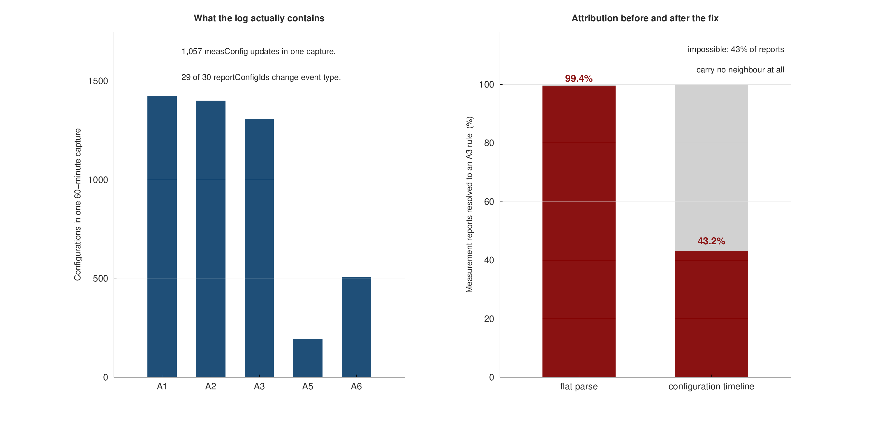
APPENDIX A - BACKUP
The configuration-timeline defect, measured
Likely question: how do you know the flat parse was wrong?
Because 43% of reports carry no neighbour, so 99.4% A3 attribution is arithmetically impossible.
The log itself shows 1,424 A1, 1,401 A2 and 1,309 A3 configurations in one capture.

Slide 38
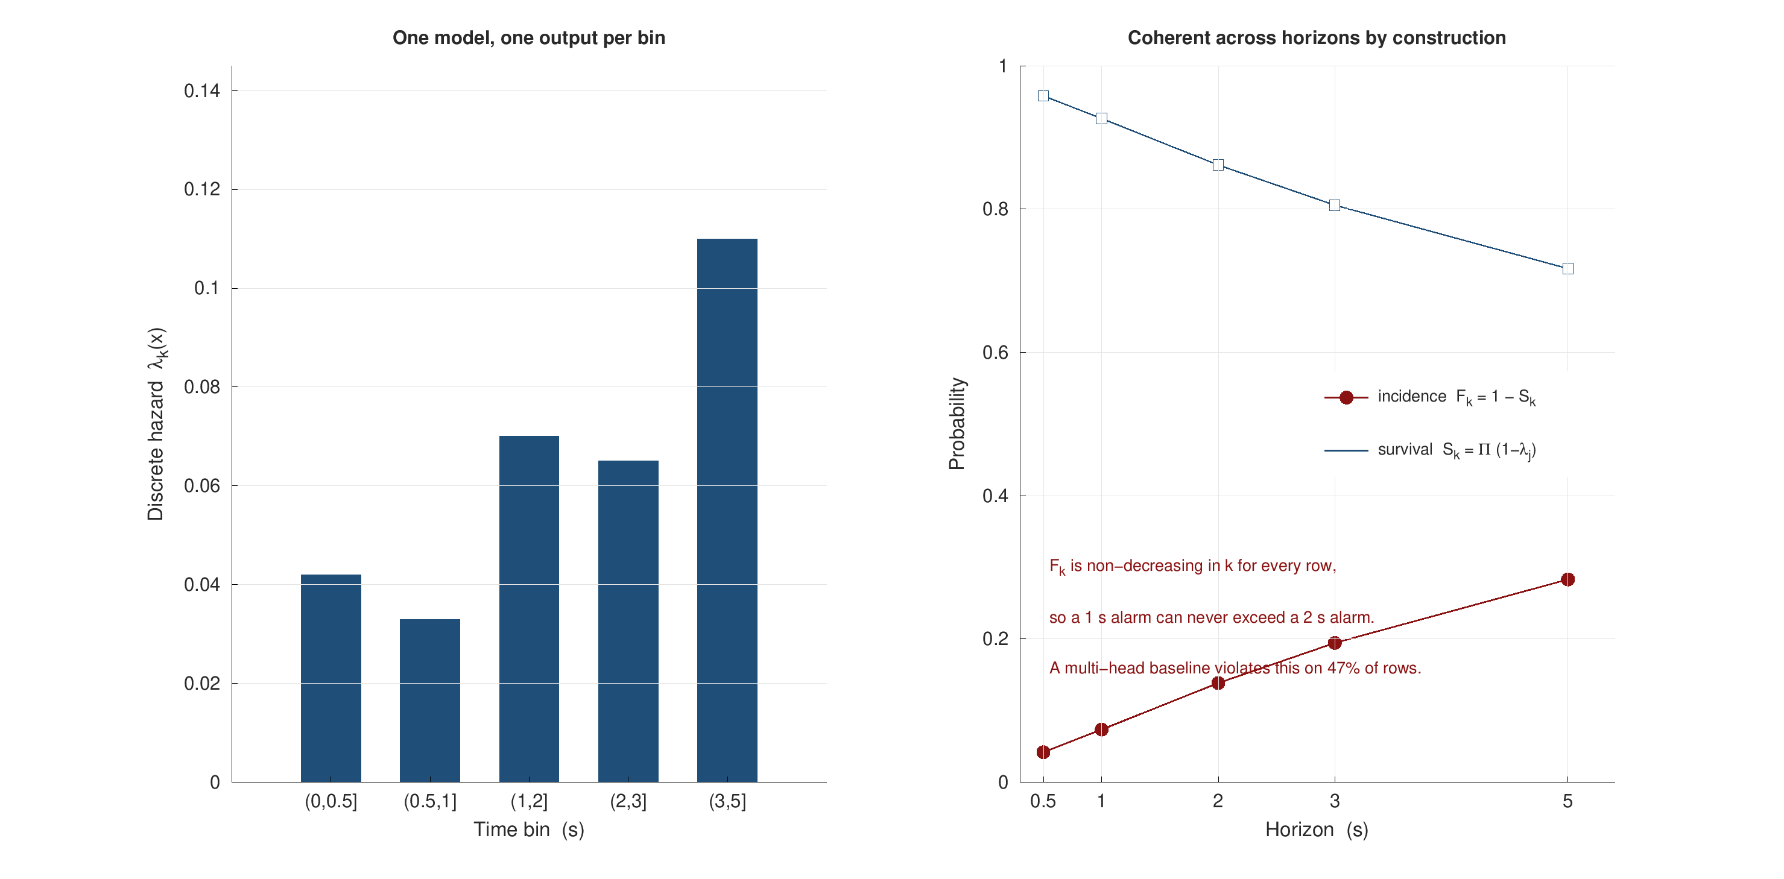
APPENDIX B - BACKUP
The hazard identity, panel by panel
Likely question: why not just calibrate five heads?
Because calibration is per horizon and nothing couples the horizons to each other.
The product-limit identity couples them before any calibration is applied.

Slide 39
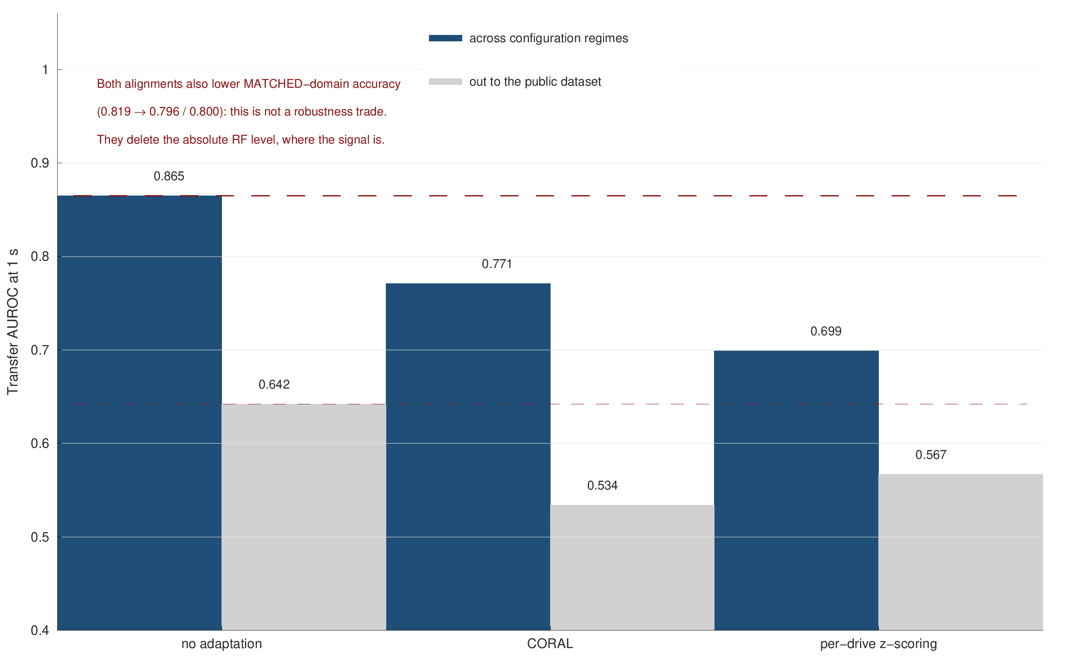
APPENDIX C - BACKUP
Domain adaptation, arm by arm
Likely question: did you try domain adaptation?
Yes, two standard unsupervised methods, and both lose on both sides of the transfer.
Matched-domain AUROC also falls (0.819 to 0.796 / 0.800), which rules out a robustness trade.

Slide 40
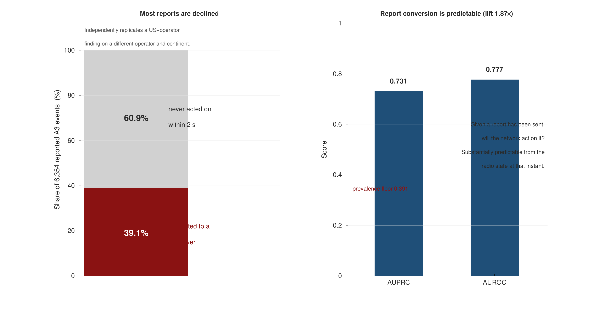
APPENDIX D - BACKUP
Report conversion, in numbers
Likely question: is report conversion just the A3 rule restated?
No: the gate is satisfied for every one of these reports, yet three in five are declined.
AUPRC 0.731 against a 0.391 floor over 6,354 reports.

Slide 41
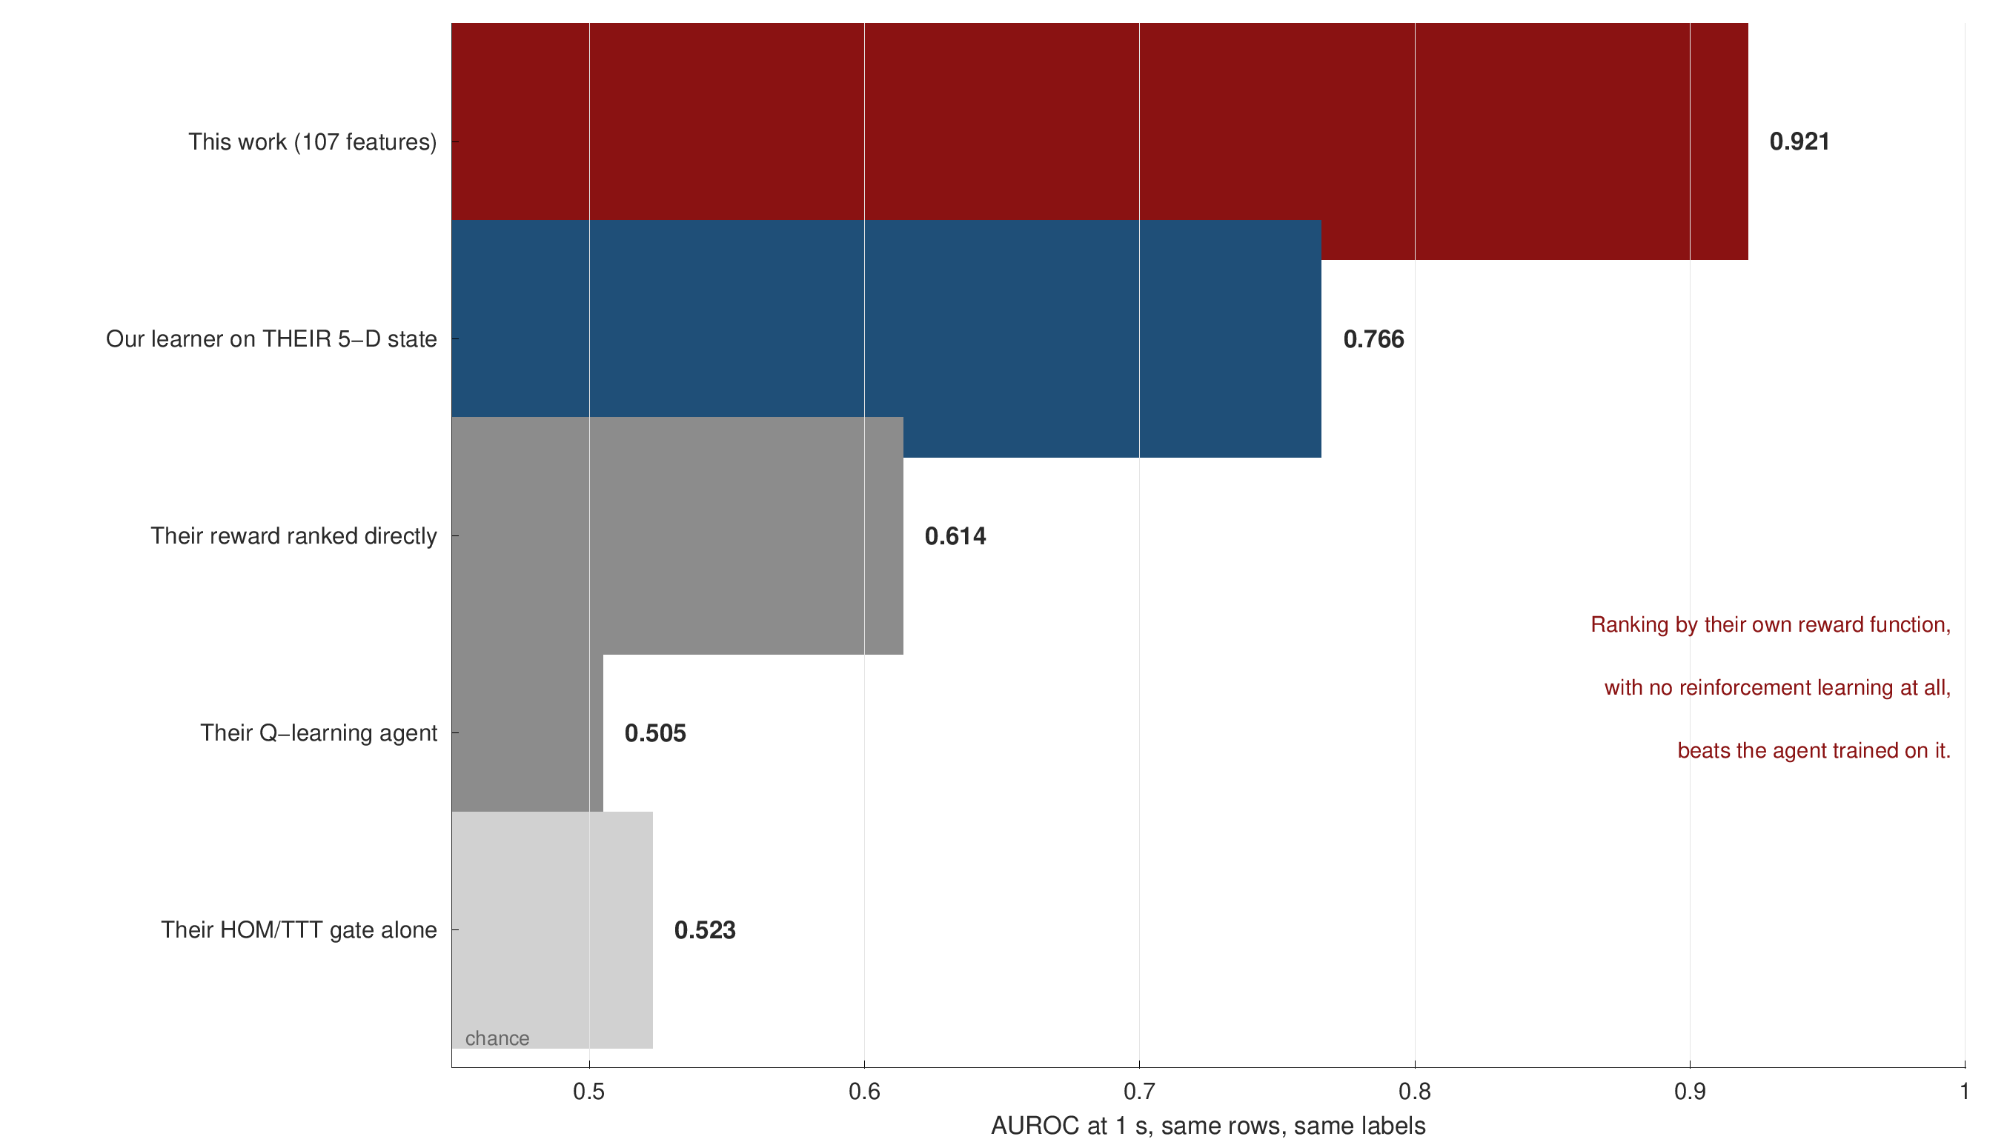
APPENDIX E - BACKUP
The departmental comparison, arm by arm
Likely question: is this a fair comparison?
Every choice was made in their favour: full learned advantage, their own row population, their more favourable gate reading.
Their published TTT filter consumes TTT seconds of the future, so it is inadmissible as evidence of prediction.

